Slide 1
OHDSI Tutorial: Patient-level predictive modelling in observational healthcare data
Faculty:
Peter Rijnbeek (Erasmus MC)
Ross Williams (Erasmus MC)
Patrick Ryan (Janssen Research and Development)
Jenna Reps (Janssen Research and Development)

Slide 2

The journey toward Patient-Level Prediction

Slide 3


Faculty
Peter Rijnbeek Erasmus MC | Ross Williams Erasmus MC | Jenna Reps Janssen R&D | Patrick Ryan Janssen R&D
Slides can be found on our Github:
https://github.com/OHDSI/Tutorial-PLP
https://www.ohdsi.org/who-we-are/collaborators/

Slide 4
Welcome to the Patient-Level Prediction Tutorial
Peter Rijnbeek

Slide 5
OHDSI’s Mission
To improve health, by empowering a community to collaboratively generate the evidence that promotes better health decisions and better care.
Hripcsak G, et al. (2015) Observational Health Data Sciences and Informatics (OHDSI): Opportunities for observational researchers. Stud Health Technol Inform 216:574–578.

Slide 6




A caricature of the patient journey
Disease
Treatment
Outcome
Conditions
Drugs
Procedures
Measurements
Person time
Baseline time
Follow-up time
0

Slide 7
Questions asked across the patient journey
Disease
Treatment
Outcome
Which treatment did patients choose after diagnosis?
Conditions
Which patients chose which treatments?
Does one treatment cause the outcome more than an alternative?
Drugs
Procedures
Measurements
How many patients experienced the outcome after treatment?
Does treatment cause outcome?
Person time
Baseline time
Follow-up time
What is the probability I will develop the disease?
0
What is the probability I will experience the outcome?

Slide 8
Complementary evidence to inform the patient journey
Clinical characterization:
What happened to them?
observation
Patient-level prediction:
What will happen to me?
Population-level effect estimation:
What are the causal effects?
inference
causal inference

Slide 9
Today’s Agenda
Time | Topic
8:45 – 9:00 | Get settled, get laptops ready
9:00 – 10:00 | Exercise: Selection of prediction problem
10:00 – 10:45 | Presentation: What is Patient-Level Prediction
10:45 – 11:00 | Break
11:00 – 11:45 | Presentation: Learning the OHDSI Patient-Level Prediction Framework
11:45 – 12:30 | Presentation: Overview of the TRIPOD Statement Exercise: Applying TRIPOD to CHADS2
12:30 – 13:15 | Lunch
13:15 – 15:15 | Guided tour through implementing patient-level prediction
15:15 – 15:30 | Break
15:30 – 16:45 | Exercise: Design and implement your own patient-level prediction
16:45 – 17:00 | Lessons Learned and Feedback

Slide 10
Selection of prediction problem
Patrick Ryan

Slide 11
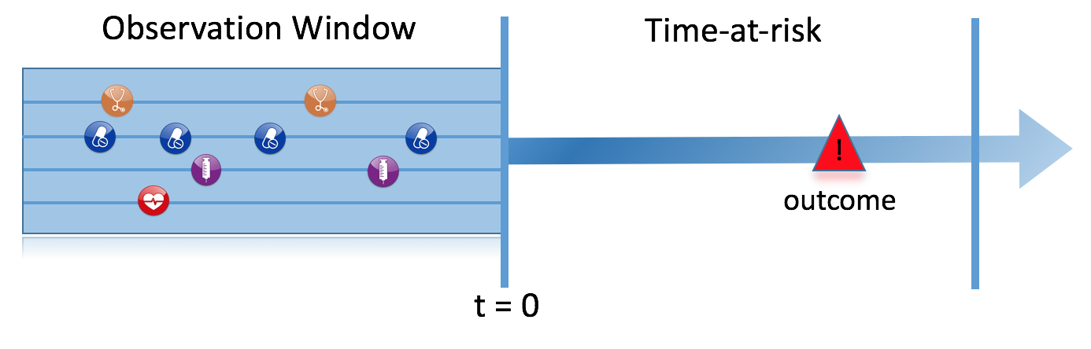
Prediction Problem Definition
Among a target population (T), we aim to predict which patients at a defined moment in time (t=0) will experience some outcome (O) during a time-at-risk Prediction is done using only information about the patients in an observation window prior to that moment in time.

Slide 12
What are the key inputs to a patient-level prediction study?
Input parameter | Design choice
Target cohort (T)
Outcome cohort (O)
Time-at-risk
Model development -which algorithm(s)? -which parameters? -which covariates?
We extract data for the patients in the Target Cohort (T) of which some will experience the outcome (O) in T
T
O

Slide 13
Types of prediction problems in healthcare
Type | Structure | Example
Disease onset and progression | Amongst patients who are newly diagnosed with <insert your favorite disease>, which patients will go on to have <another disease or related complication> within <time horizon from diagnosis>? | Among newly diagnosed AFib patients, which will go onto to have ischemic stroke in next 3 years?
Treatment choice | Amongst patients with <indicated disease> who are treated with either <treatment 1> or <treatment 2>, which patients were treated with <treatment 1> (on day 0)? | Among AFib patients who took either warfarin or rivaroxaban, which patients got warfarin? (as defined for propensity score model)
Treatment response | Amongst patients who are new users of <insert your favorite chronically-used drug>, which patients will <insert desired effect> in <time window>? | Which patients with T2DM who start on metformin stay on metformin after 3 years?
Treatment safety | Amongst patients who are new users of <insert your favorite drug>, which patients will experience <insert your favorite known adverse event from the drug profile> within <time horizon following exposure start>? | Among new users of warfarin, which patients will have GI bleed in 1 year?
Treatment adherence | Amongst patients who are new users of <insert your favorite chronically-used drug>, which patients will achieve <adherence metric threshold> at <time horizon>? | Which patients with T2DM who start on metformin achieve >=80% proportion of days covered at 1 year?

Slide 14
Types of prediction problems in healthcare
Type | Structure | Example
Disease onset and progression | Amongst patients who are newly diagnosed with <insert your favorite disease>, which patients will go on to have <another disease or related complication> within <time horizon from diagnosis>? | Among newly diagnosed AFib patients, which will go onto to have ischemic stroke in next 3 years?
Treatment choice | Amongst patients with <indicated disease> who are treated with either <treatment 1> or <treatment 2>, which patients were treated with <treatment 1> (on day 0)? | Among AFib patients who took either warfarin or rivaroxaban, which patients got warfarin? (as defined for propensity score model)
Treatment response | Amongst patients who are new users of <insert your favorite chronically-used drug>, which patients will <insert desired effect> in <time window>? | Which patients with T2DM who start on metformin stay on metformin after 3 years?
Treatment safety | Amongst patients who are new users of <insert your favorite drug>, which patients will experience <insert your favorite known adverse event from the drug profile> within <time horizon following exposure start>? | Among new users of warfarin, which patients will have GI bleed in 1 year?
Treatment adherence | Amongst patients who are new users of <insert your favorite chronically-used drug>, which patients will achieve <adherence metric threshold> at <time horizon>? | Which patients with T2DM who start on metformin achieve >=80% proportion of days covered at 1 year?
Type | Structure
Disease onset and progression | Amongst patients who are newly diagnosed with <insert your favorite disease>, which patients will go on to have <another disease or related complication> within <time horizon from diagnosis>? Among newly diagnosed AFib patients, which will go onto to have ischemic stroke in next 3 years?

Slide 15
Types of prediction problems in healthcare
Type | Structure | Example
Disease onset and progression | Amongst patients who are newly diagnosed with <insert your favorite disease>, which patients will go on to have <another disease or related complication> within <time horizon from diagnosis>? | Among newly diagnosed AFib patients, which will go onto to have ischemic stroke in next 3 years?
Treatment choice | Amongst patients with <indicated disease> who are treated with either <treatment 1> or <treatment 2>, which patients were treated with <treatment 1> (on day 0)? | Among AFib patients who took either warfarin or rivaroxaban, which patients got warfarin? (as defined for propensity score model)
Treatment response | Amongst patients who are new users of <insert your favorite chronically-used drug>, which patients will <insert desired effect> in <time window>? | Which patients with T2DM who start on metformin stay on metformin after 3 years?
Treatment safety | Amongst patients who are new users of <insert your favorite drug>, which patients will experience <insert your favorite known adverse event from the drug profile> within <time horizon following exposure start>? | Among new users of warfarin, which patients will have GI bleed in 1 year?
Treatment adherence | Amongst patients who are new users of <insert your favorite chronically-used drug>, which patients will achieve <adherence metric threshold> at <time horizon>? | Which patients with T2DM who start on metformin achieve >=80% proportion of days covered at 1 year?
Type | Structure
Treatment choice | Amongst patients with <indicated disease> who are treated with either <treatment 1> or <treatment 2>, which patients were treated with <treatment 1> (on day 0)? Among AFib patients who took either warfarin or rivaroxaban, which patients got warfarin? (as defined for propensity score model)

Slide 16
Types of prediction problems in healthcare
Type | Structure | Example
Disease onset and progression | Amongst patients who are newly diagnosed with <insert your favorite disease>, which patients will go on to have <another disease or related complication> within <time horizon from diagnosis>? | Among newly diagnosed AFib patients, which will go onto to have ischemic stroke in next 3 years?
Treatment choice | Amongst patients with <indicated disease> who are treated with either <treatment 1> or <treatment 2>, which patients were treated with <treatment 1> (on day 0)? | Among AFib patients who took either warfarin or rivaroxaban, which patients got warfarin? (as defined for propensity score model)
Treatment response | Amongst patients who are new users of <insert your favorite chronically-used drug>, which patients will <insert desired effect> in <time window>? | Which patients with T2DM who start on metformin stay on metformin after 3 years?
Treatment safety | Amongst patients who are new users of <insert your favorite drug>, which patients will experience <insert your favorite known adverse event from the drug profile> within <time horizon following exposure start>? | Among new users of warfarin, which patients will have GI bleed in 1 year?
Treatment adherence | Amongst patients who are new users of <insert your favorite chronically-used drug>, which patients will achieve <adherence metric threshold> at <time horizon>? | Which patients with T2DM who start on metformin achieve >=80% proportion of days covered at 1 year?
Type | Structure
Treatment response | Amongst patients who are new users of <insert your favorite chronically-used drug>, which patients will <insert desired effect> in <time window>? Which patients with T2DM who start on metformin stay on metformin after 3 years?

Slide 17
Types of prediction problems in healthcare
Type | Structure | Example
Disease onset and progression | Amongst patients who are newly diagnosed with <insert your favorite disease>, which patients will go on to have <another disease or related complication> within <time horizon from diagnosis>? | Among newly diagnosed AFib patients, which will go onto to have ischemic stroke in next 3 years?
Treatment choice | Amongst patients with <indicated disease> who are treated with either <treatment 1> or <treatment 2>, which patients were treated with <treatment 1> (on day 0)? | Among AFib patients who took either warfarin or rivaroxaban, which patients got warfarin? (as defined for propensity score model)
Treatment response | Amongst patients who are new users of <insert your favorite chronically-used drug>, which patients will <insert desired effect> in <time window>? | Which patients with T2DM who start on metformin stay on metformin after 3 years?
Treatment safety | Amongst patients who are new users of <insert your favorite drug>, which patients will experience <insert your favorite known adverse event from the drug profile> within <time horizon following exposure start>? | Among new users of warfarin, which patients will have GI bleed in 1 year?
Treatment adherence | Amongst patients who are new users of <insert your favorite chronically-used drug>, which patients will achieve <adherence metric threshold> at <time horizon>? | Which patients with T2DM who start on metformin achieve >=80% proportion of days covered at 1 year?
Type | Structure
Treatment safety | Amongst patients who are new users of <insert your favorite drug>, which patients will experience <insert your favorite known adverse event from the drug profile> within <time horizon following exposure start>? Among new users of warfarin, which patients will have GI bleed in 1 year?

Slide 18
Types of prediction problems in healthcare
Type | Structure | Example
Disease onset and progression | Amongst patients who are newly diagnosed with <insert your favorite disease>, which patients will go on to have <another disease or related complication> within <time horizon from diagnosis>? | Among newly diagnosed AFib patients, which will go onto to have ischemic stroke in next 3 years?
Treatment choice | Amongst patients with <indicated disease> who are treated with either <treatment 1> or <treatment 2>, which patients were treated with <treatment 1> (on day 0)? | Among AFib patients who took either warfarin or rivaroxaban, which patients got warfarin? (as defined for propensity score model)
Treatment response | Amongst patients who are new users of <insert your favorite chronically-used drug>, which patients will <insert desired effect> in <time window>? | Which patients with T2DM who start on metformin stay on metformin after 3 years?
Treatment safety | Amongst patients who are new users of <insert your favorite drug>, which patients will experience <insert your favorite known adverse event from the drug profile> within <time horizon following exposure start>? | Among new users of warfarin, which patients will have GI bleed in 1 year?
Treatment adherence | Amongst patients who are new users of <insert your favorite chronically-used drug>, which patients will achieve <adherence metric threshold> at <time horizon>? | Which patients with T2DM who start on metformin achieve >=80% proportion of days covered at 1 year?
Type | Structure
Treatment adherence | Amongst patients who are new users of <insert your favorite chronically-used drug>, which patients will achieve <adherence metric threshold> at <time horizon>? Which patients with T2DM who start on metformin achieve >=80% proportion of days covered at 1 year?

Slide 19
Types of prediction problems in healthcare
Type | Structure | Example
Disease onset and progression | Amongst patients who are newly diagnosed with <insert your favorite disease>, which patients will go on to have <another disease or related complication> within <time horizon from diagnosis>? | Among newly diagnosed AFib patients, which will go onto to have ischemic stroke in next 3 years?
Treatment choice | Amongst patients with <indicated disease> who are treated with either <treatment 1> or <treatment 2>, which patients were treated with <treatment 1> (on day 0)? | Among AFib patients who took either warfarin or rivaroxaban, which patients got warfarin? (as defined for propensity score model)
Treatment response | Amongst patients who are new users of <insert your favorite chronically-used drug>, which patients will <insert desired effect> in <time window>? | Which patients with T2DM who start on metformin stay on metformin after 3 years?
Treatment safety | Amongst patients who are new users of <insert your favorite drug>, which patients will experience <insert your favorite known adverse event from the drug profile> within <time horizon following exposure start>? | Among new users of warfarin, which patients will have GI bleed in 1 year?
Treatment adherence | Amongst patients who are new users of <insert your favorite chronically-used drug>, which patients will achieve <adherence metric threshold> at <time horizon>? | Which patients with T2DM who start on metformin achieve >=80% proportion of days covered at 1 year?

Slide 20
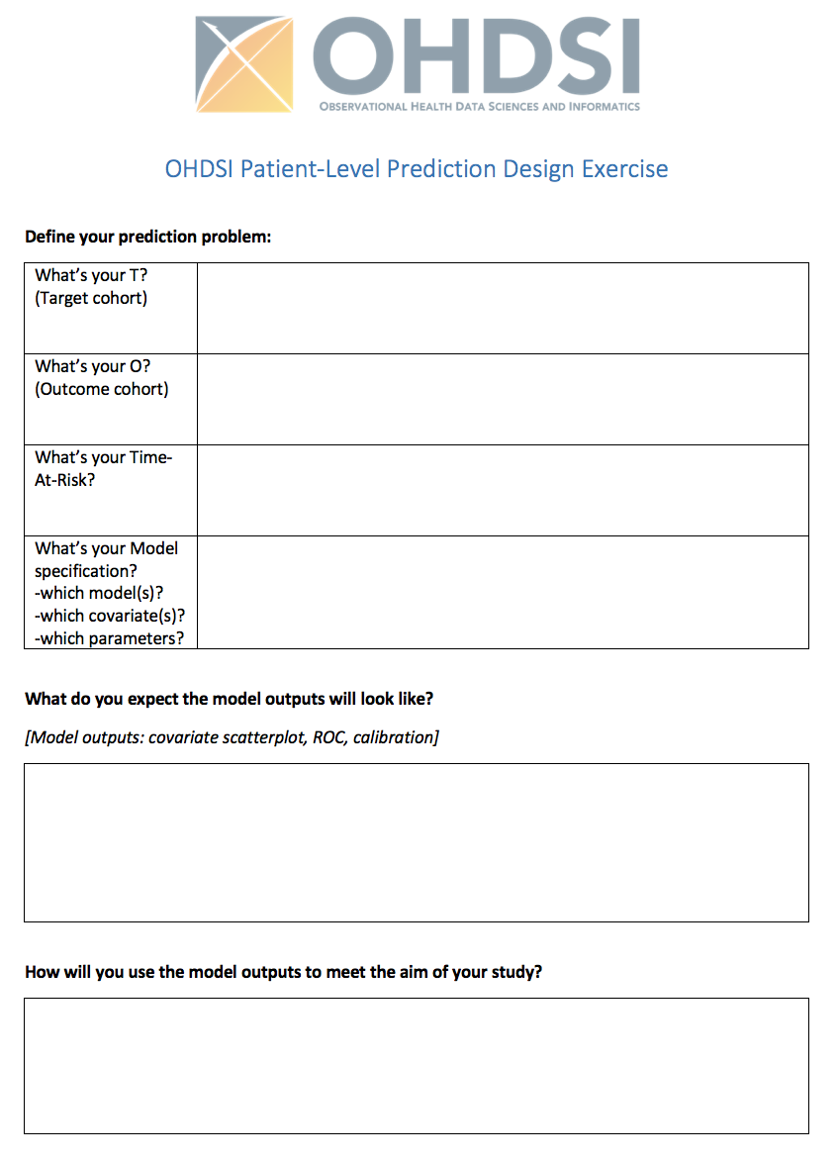
What is your prediction problem?
Fill in your form (10 min)
Discuss your prediction problem in your group (20 min)
Select one prediction problem
Report back and promote your choice
Voting on prediction problem to implement after lunch

Slide 22
What is your prediction problem?
You have 30 minutes for step 1 - 3
Fill in your form (10 min)
Discuss your prediction problem in your group (20 min)
Select one prediction problem
Report back and promote your choice
Voting on prediction problem to implement after lunch

Slide 23

Group Discussion
The best prediction problem ever…
T
O
TAR

Slide 24
Today’s Agenda
Time | Topic
8:45 – 9:00 | Get settled, get laptops ready
9:00 – 10:00 | Exercise: Selection of prediction problem
10:00 – 10:45 | Presentation: What is Patient-Level Prediction
10:45 – 11:00 | Break
11:00 – 11:45 | Presentation: Learning the OHDSI Patient-Level Prediction Framework
11:45 – 12:30 | Presentation: Overview of the TRIPOD Statement Exercise: Applying TRIPOD to CHADS2
12:30 – 13:15 | Lunch
13:15 – 15:15 | Guided tour through implementing patient-level prediction
15:15 – 15:30 | Break
15:30 – 16:45 | Exercise: Design and implement your own patient-level prediction
16:45 – 17:00 | Lessons Learned and Feedback

Slide 25
What is Patient-Level Prediction?
Peter Rijnbeek, PhD
Erasmus MC

Slide 26
Learning Objectives
Part 1: Learn what a patient-level prediction model is?
Part 2: Understand the patient-level prediction modelling process
Part 3: Gain insights from a proof-of-concept study in depression patients
Notes:
soe

Slide 27
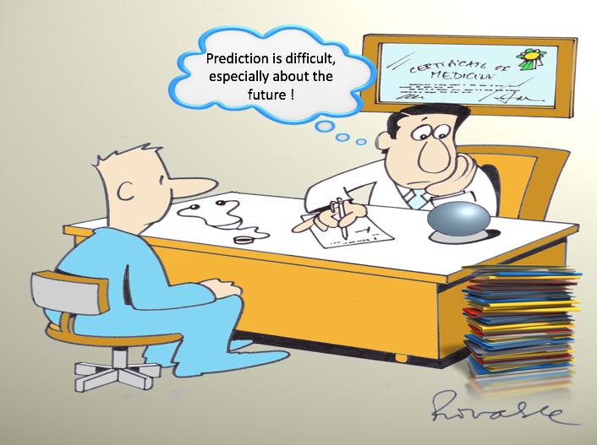
Clinicians are confronted with prediction questions on a daily basis. What options do they have?
Deny ability to predict at the individual patient level
Quote an overall average to all patients
Provide a personalized prediction based on an advanced clinical prediction model
Utilize knowledge and personal experience
Notes:
Doctors are asked to give predictions on a daily basis as shown in this cartoon of a atrial fibrillation patient with the question “What is my risk of stroke in the next year now I have Atrial fibrillation?”
What are the options a clinician has when confronted with a prediction question?
He could of course deny the ability to predict at the individual patient level and, although this is not the answer the patient wants to hear, this is sometimes to most sensible answer to give.
He could also quote an overall average to all patients with same age an gender, which is what Patrick has shown in his presentation about data characterization.
Often the doctor tries to give an answer based on his knowledge and experience with patients that have a comparable medical history as the patient in front of him.
This task is very difficult for a a human to fullfill because prediction is rarely based on a single factor but is a combination of multiple predictiors. The big question here is which are the predictors that need to be taken under consideration?
Ideally, he would have access to a prediction model that will predict the risk of this patient with all his medical history. This requires the development of an advanced patient-level prediction model.
As the great Danish physicist Niels Bohr said ”It is very difficult to predict, especially the future”. It is hard to know the current state you are in let alone what will happen to you in the future.
I think Bohr is right, it is a challenging task, but still I believe that in the data rich time we currently live and with the computer power we have for our modelling work, we are able to make big contributions to the field of patient-level predictive modelling.
This is the reason we have put patient-level predictive modeling high on the agenda of the OHDSI initiative and have created a patient-level prediction workgroup started lst year let by me and Jenna Reps.
We believe OHDSI is especially well equipped to move this field further because of the enormous energy that has been put in the standardization of data through the OMOP CDM and the vocabulary and the excellent multi-disciplinary expertise that is available.

Slide 28
Problem definition
Among a target population (T), we aim to predict which patients at a defined moment in time (t=0) will experience some outcome (O) during a time-at-risk Prediction is done using only information about the patients in an observation window prior to that moment in time.
Notes:
To make this a bit more concrete I have added this figure. It defines the problem as “among a population at risk…

Slide 29
What are the key inputs to a patient-level prediction study?
Input parameter | Design choice
Target cohort (T)
Outcome cohort (O)
Time-at-risk
Model specification -which model(s)? -which parameters? -which covariates?
We extract data for the patients in the Target Cohort (T) and we select all patients that experience the outcome (O) in T
T
O

Slide 30

Difference between explanatory models and prediction models
People build a prediction model and make causal claims. This is not correct!
Why

Slide 31
Different interpretations of ”Model”
”Model” is being interpreted differently in Statistics, Epidemiology, and Data Science
Statistics: models are used to describe data, it is more about data characterization
Epidemiologist are trained to think about models as tests of hypotheses to perform causal inference
Data Scientists interpret the word “model” in the context of predicting future events using the available data
It is important we understand what the difference is between explanatory modelling and predictive modelling!
Shmueli, G. 2011. Predictive Analytics in Information Systems Research. MIS Quarterly (35:3), pp. 553-57
Shmueli, G. 2010. To Explain or to Predict?, Statistical Science (25:3), pp. 289-310

Slide 32
Some definitions
Explanatory Model: Theory-based statistical model for testing causal hypotheses
Explanatory Power: Strength of the relationship in statistical model
Predictive Model: Empirical model/algorithm for predicting new observations
Predictive Power: Ability to accurately predict new observations
You can empirically evaluate the predictive power of explanatory model but you cannot empirically evaluate the explanatory power of a predictive model.
The best explanatory model is not necessary the best predictive model!
You do not have to understand the underlying causes in order to predict well!

Slide 33
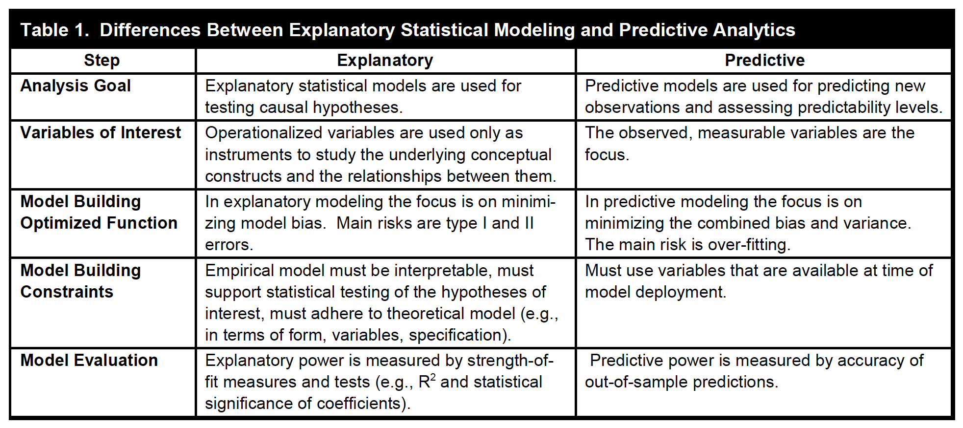
Explanatory modelling versus Predictive analytics
Shmueli, G. 2011. Predictive Analytics in Information Systems Research. MIS Quarterly (35:3), pp. 553-57

Slide 34
Why should we avoid the term “Risk Factor”
“Risk Factor” is an ambiguous term.
A predictive model is not selecting parameters based on their explanatory power but it is using association to improve predictive accuracy -> association does not equal causation!
If your goal is to search for causal factors you should use population-level effect estimation.
If your goal is to search for association of individual parameters you should use clinical characterization.
We should avoid using the term “risk factors” and use the term predictors to make explicit that we are assessing predictive value.

Slide 35
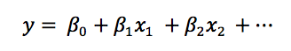
How to interpret beta values in a logistic regression prediction model?
Each beta coefficient represents the additional effect of adding that variable to the model,
if the effects of all other variables in the model are already accounted for.
any change of the model can result in a change of all the beta coefficients
Value | Association | Causation
b = 0 | Unknown | Unknown
b <> 0 | Yes | Unknown
b > 0 | Positively associated under the assumption that all other beta values are fixed. If the variable is correlated to any other variable the direction of the association is unknown | Unknown
b < 0 | Negatively associated under the assumption that all other beta values are fixed. If the variable is correlated to any other variable the direction of the association is unknown | Unknown

Slide 36
Why is predictive modelling still valuable?
In healthcare the question “What is going to happen to me?” is often more relevant than “Why?”
Knowing if something is predictable or not based on the available data is valuable on its own.

Slide 37
Types of prediction problems in healthcare
Type | Structure | Example
Disease onset and progression | Amongst patients who are newly diagnosed with <insert your favorite disease>, which patients will go on to have <another disease or related complication> within <time horizon from diagnosis>? | Among newly diagnosed AFib patients, which will go onto to have ischemic stroke in next 3 years?
Treatment choice | Amongst patients with <indicated disease> who are treated with either <treatment 1> or <treatment 2>, which patients were treated with <treatment 1> (on day 0)? | Among AFib patients who took either warfarin or rivaroxaban, which patients got warfarin? (as defined for propensity score model)
Treatment response | Amongst patients who are new users of <insert your favorite chronically-used drug>, which patients will <insert desired effect> in <time window>? | Which patients with T2DM who start on metformin stay on metformin after 3 years?
Treatment safety | Amongst patients who are new users of <insert your favorite drug>, which patients will experience <insert your favorite known adverse event from the drug profile> within <time horizon following exposure start>? | Among new users of warfarin, which patients will have GI bleed in 1 year?
Treatment adherence | Amongst patients who are new users of <insert your favorite chronically-used drug>, which patients will achieve <adherence metric threshold> at <time horizon>? | Which patients with T2DM who start on metformin achieve >=80% proportion of days covered at 1 year?

Slide 38


Questions?

Slide 39
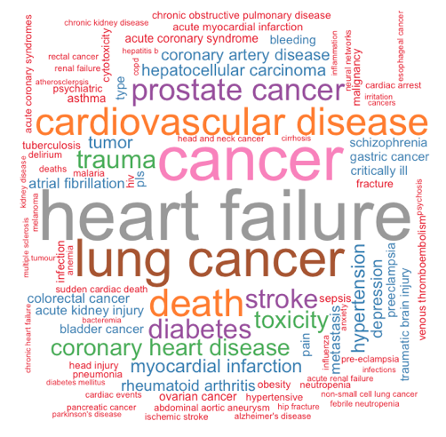
Growing interest in prediction modelling
Notes:
As shown here on the left there is a very strong increase in the number of papers about prediction models. Many different terms are used, e.g. prognostic models, risk scores, prediction index etc.
On the right a so called Wordle is shown which shows the diseases that are being studied in these papers. I created this plot by performing a pubmed search on these terms and then subsequently I annotated all the diseases that were mentioned in the title using a text mining approach implemented in R. The bigger the word the more often the disease was studied. Heart failure was studied most often but also our Stroke and Depression appear in the wordle.

Slide 40
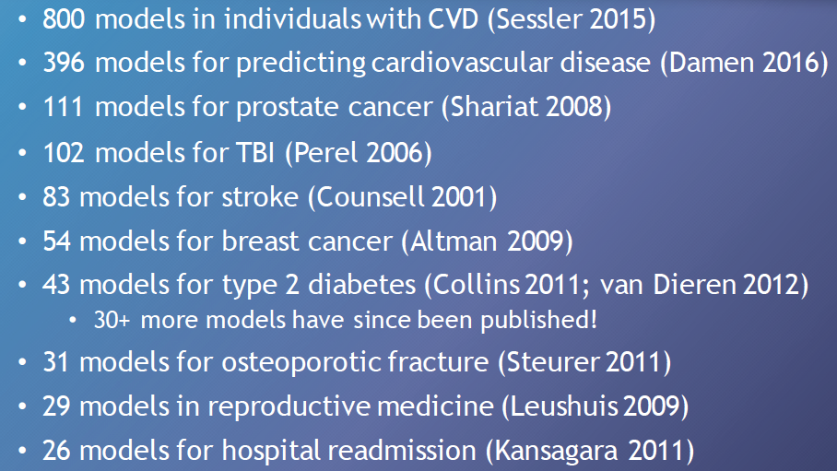
Reviews of published prediction models
Courtesy of Gary Collins
Notes:
Interestingly, many prediction models have been developed for the same outcomes. In this slide a selection of reviews is presented that have assessed the prediction models in a specific disease area.
Note that there exist 83 models for stroke and probably many more.

Slide 41
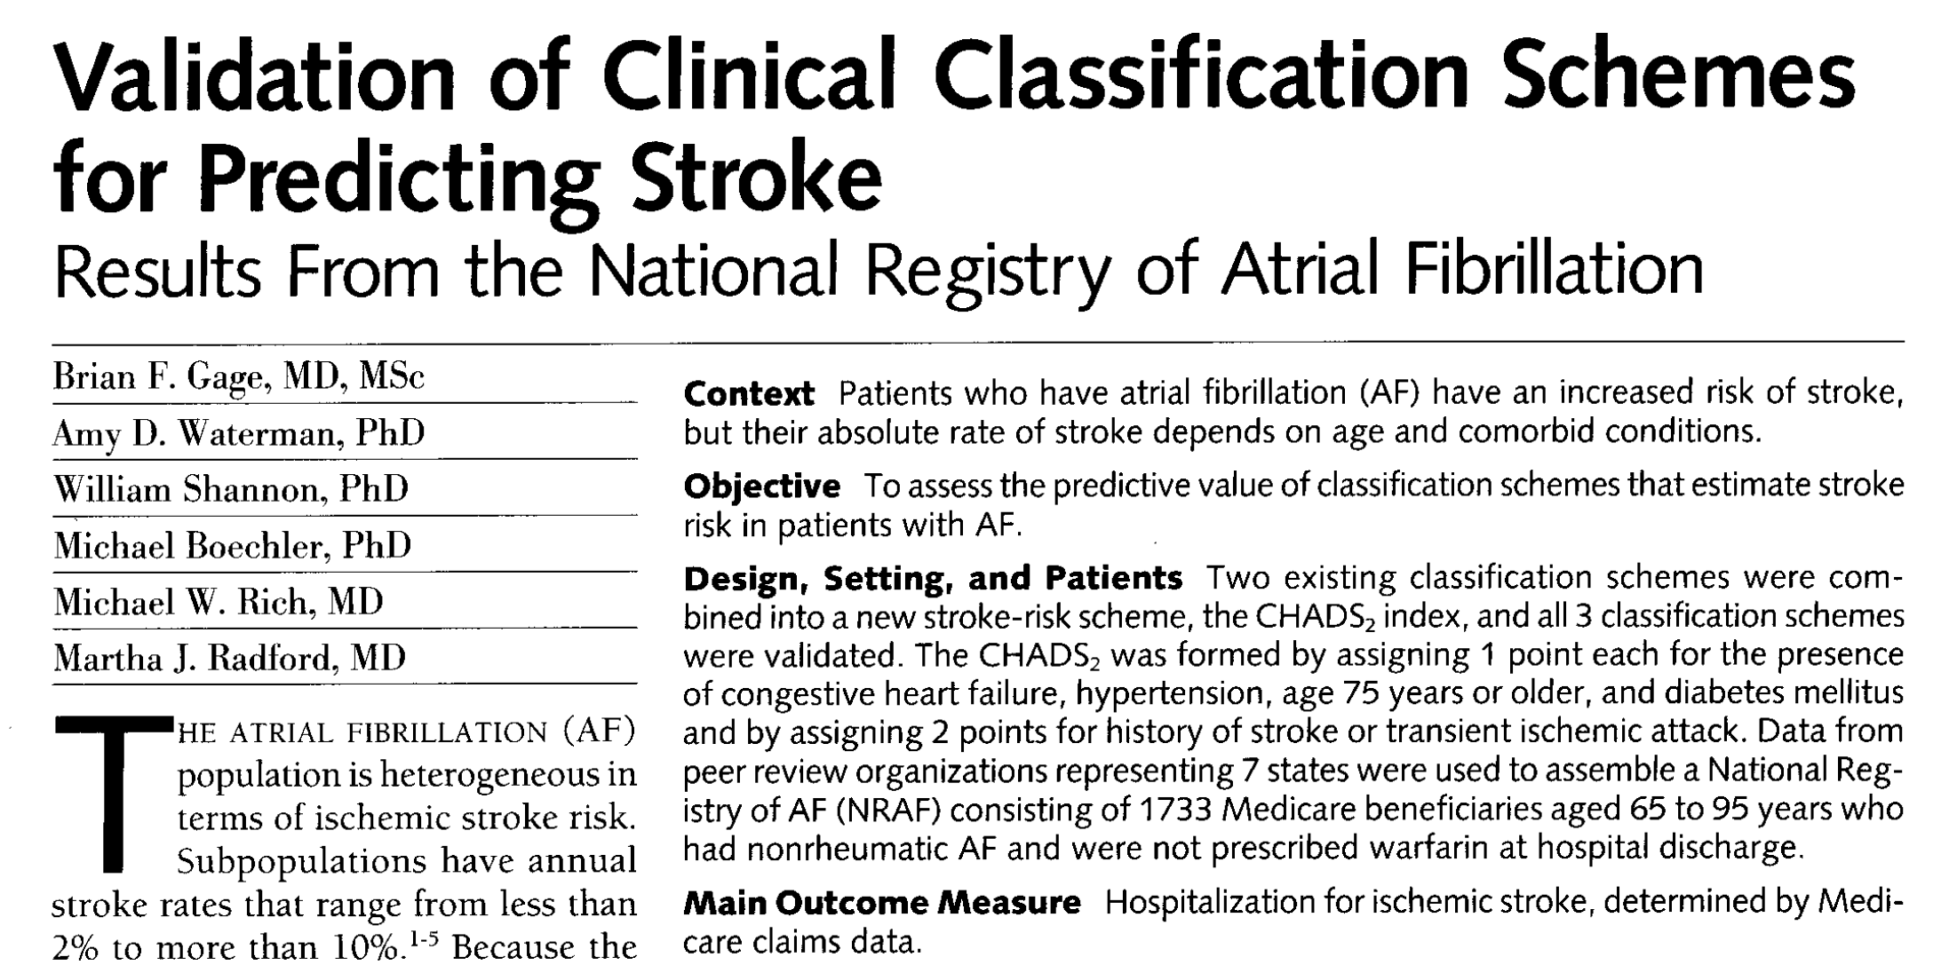
Predicting Stroke in patients with atrial fibrillation
CHADS2 | Score
Congestive Heart Failure | 1
Hypertension | 1
Age > 75 | 1
Diabetes | 1
Stroke / TIA | 2
Notes:
More recently an updated version is developed that is better capable of distinguishing patients at low risk of stroke. This model is adopted in the guidelines of the American Heart Association for risk assessment.
Note that this model is built for patients with nonvalvular atrial fibrillation and it has not been studied in depression.
For each cohort at risk we need to build a tuned prediction model to obtain optimal predictive performance.

Slide 42
How to define the CHADS₂ patient-level prediction problem?
Input parameter | Design choice
Target cohort (T) | Patients newly diagnosed with AF
Outcome cohort (O) | Stroke
Time-at-risk | 1000 days
Model specification | Logistic Regression using 5 pre-selected predictors

Slide 43
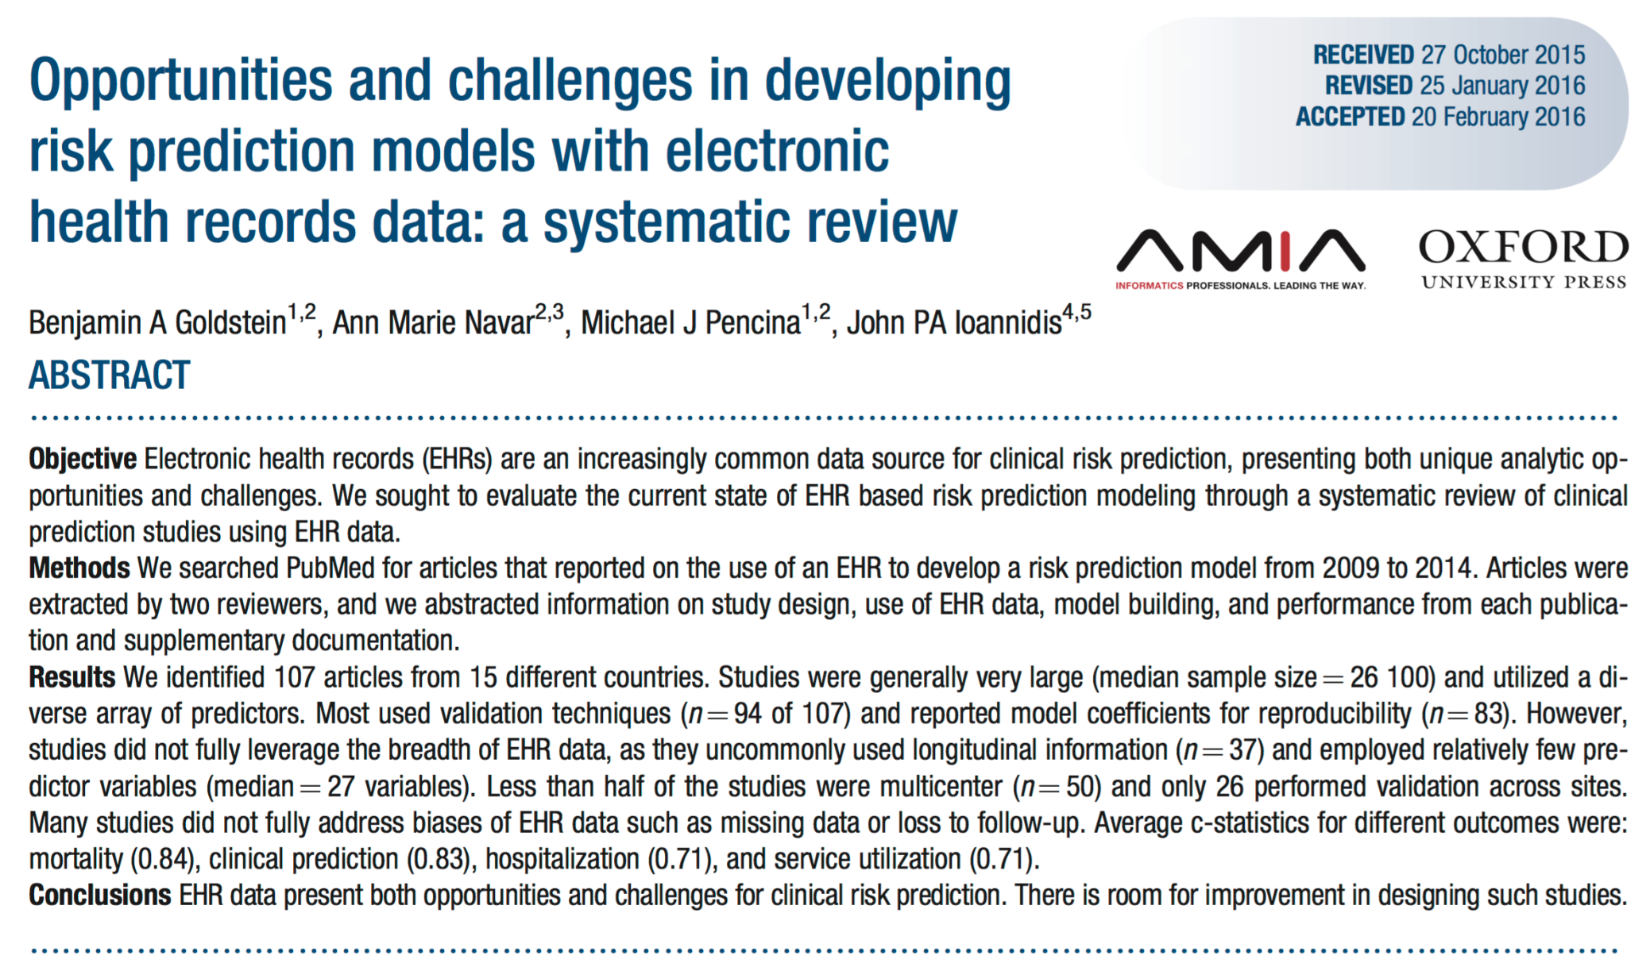
Current status of predictive modelling
Goldstein BA, J Am Med Inform Assoc. 2016.
Notes:
Unfortunately, the more recent reviews on prediction models show that there is still a lot of room for improvement.
Click -> see slide
There are many more reviews in disease area’s that discuss the same shortcomings.

Slide 44
Current status of predictive modelling
Inadequate internal validation
Small sets of features
Incomplete dissemination of model and results
No transportability assessment
Impact on clinical decision making unknown
Relatively few prediction models are used in clinical practice
Notes:
Often these studies have methodological issues, for example inadequate training and testing of the model or missing rationale for the model choice.
Almost all these models are trained on a small set of features selected using a knowledge driven approach. We believe it would be better to include all the prior information available in the medical record and let the algorithm select the best for prediction
Dissemination of the model and results is also often suboptimal, for example the full model is not shared which makes it impossible for others to apply the model, or results do not contain the necessary performance measures.
Assessment of portability of the models is often not include in the paper. How well does this model perform on other datasets than used for training.
Only few clinical impact studies have been performed in which the clinical usefulness is assessed. This is a very challenging task.
The result is that relatively few prediction models are really used in clinical practice.

Slide 45
OHDSI Mission for Patient-Level Prediction
OHDSI aims to develop a systematic process to learn and evaluate large-scale patient-level prediction models using observational health data in a data network
Evidence
Generation
Evidence
Evaluation
Evidence
Dissemination
Notes:
How do we think we can contribute in this interesting research field.
Read statement.
I like to highlight a couple of words in this statement.
We think it is crucial to move the field that systematic processes are applied following best-practices that have been agreed upon a priori. This does not only refer to standardized tools for model development and validation but is also refers to best-practices for model and result dissemination.
We want to facilitate large-scale model development. This refers to the large populations that are available but even more so the the large amount of information in the clinical data. We want to build prediction models leveraging the full health record using a data driven approach.
In the next slides I will take you through the process of Evidence Generation (how to develop the models?), Evidence Evaluation (how to evaluate the models?), Evidence Dissemination (how to share the results and models?). I will give you insight in our best-practices and will give you the necessary background to understand the results of proof of concept study.

Slide 46
Part 2: How to build and validate a prediction model?

Slide 47
Prediction Model Development
Training
Internal Validation
Data Extraction
External Validation
Dissemination
Problem Definition
Problem pre-specification. A study protocol should unambiguously pre-specify the planned analyses.
Transparency. Others should be able to reproduce a study in every detail using the provided information. All analysis code should be made available as open source on the OHDSI Github.
Notes:
We believe the first step is a clear problem definition, i.e. a study protocol needs to be shared that unambiguously pre-specifies the planned analyses. This enables full transparency and reproducibility of the study. In OHDSI open-source is therefore the standard, all code is shared through a Github repository and a new study is launched to the OHDSI data network by posting the the study protocol in an online repository.

Slide 48
Prediction Model Development
Training
Internal Validation
Data Extraction
External Validation
Dissemination
Problem Definition
The Target Cohort (T) and Outcome Cohort (O) can be defined using ATLAS or custom code (see later today).
For model development all outcomes (O) of patients in the Target Cohort (T) are used.
T
O
We extract data for the patients in the Target Cohort (T) and we select all patients that experience the outcome (O)
Notes:
Tools have been developed to extract data for all patients in a certain cohort of interest. This R-package called FeatureExtraction allows for feature selection, e.g by domain (drugs, conditions, measurements etc)
Data characterization and cleaning are important. As explained in the presentation of Patrick data characterization should be the initial step of every study to gain insight in the available data.
Data cleaning is often needed to handing outliers in the data and proper handling of missing values.

Slide 49
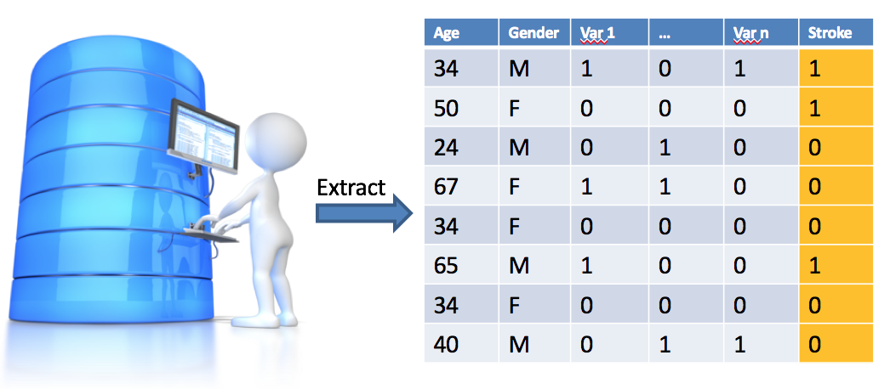
Prediction Model Development
Training
Internal Validation
Data Extraction
External Validation
Dissemination
Problem Definition
Data is extracted from the OMOP CDM using the Feature Extraction R-Package.
This allows for specification of the candidate predictors and time windows.
Notes:
Tools have been developed to extract data for all patients in a certain cohort of interest. This R-package called FeatureExtraction allows for feature selection, e.g by domain (drugs, conditions, measurements etc)
Data characterization and cleaning are important. As explained in the presentation of Patrick data characterization should be the initial step of every study to gain insight in the available data.
Data cleaning is often needed to handing outliers in the data and proper handling of missing values.

Slide 50
Prediction Model Development
Training
Internal Validation
Data Extraction
External Validation
Dissemination
Problem Definition
Model training and Internal validation is done using a train test split:
Person split: examples are assigned randomly to the train or test set, or
Time split: a split is made at a moment in time (temporal validation)
Train set Test set
2014-01-15
Notes:
The main blocks of model development consist of model trainin and internal validation. I will now dive deeper in these steps to give you the necessary background to understand the experiment that we have performed as a proof of concept in the patients with Pharmaceutically Treated Depression.

Slide 51

Model Training
Which models?
How to evaluate the model?
Training set
Internal validation
Test set
Notes:
On this slide the prediction problem is show again. (repeat problem)
This initiates the follow questions… see slide

Slide 52
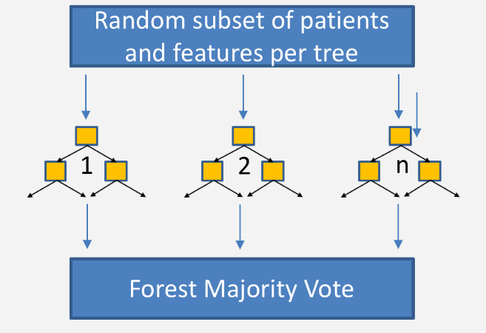
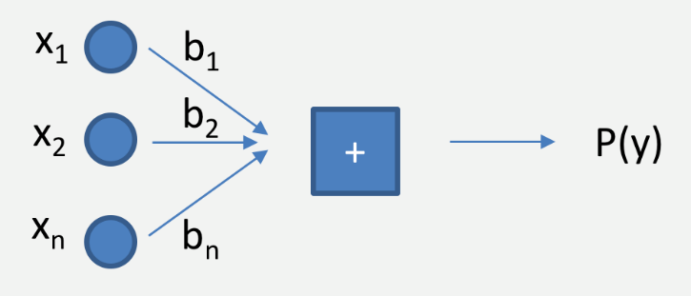
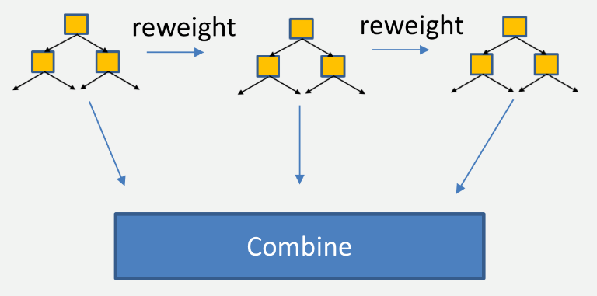
Models and Algorithms
Regularized Logistic Regression
Random Forest
Gradient Boosting Machines
Many other models for example:
K-nearest neighbors
Naïve Bayes
Decision Tree
Adaboost
Neural Network
Deep Learning
Etc.
Notes:
Many machine learning algorithms exist that could be trained for our prediction task.
As I mentioned before we believe multiple model types should be trained and evaluated and no a-priori choice should be made.
I will now give you a little bit of background on these 4 models.

Slide 53
Model selection is an empirical process
The “No Free Lunch” theorem states that there is not one model that works best for every problem. The assumptions of a great model for one problem may not hold for another problem.
It is common in machine learning to try multiple models and find one that works best for that particular problem.
see no-free-lunch.org
Notes:
Many machine learning algorithms exist that could be trained for our prediction task.
As I mentioned before we believe multiple model types should be trained and evaluated and no a-priori choice should be made.
I will now give you a little bit of background on these 4 models.

Slide 54

OHDSI Model Selection Strategy
N = 1, default model parameters
Suggested ordering of available algorithms in PLP package
N Algorithms
Lasso Logistic Regression
Random Forest
Gradient Boosting Machine
Neural Network
KNN
M. …
Performance of algorithm N adequate?
Yes
No
Changing models parameters helped?
report model
and results
N+1
No
Yes
RESEARCH
N = M
Change Covariates?
Change Database?
Adequate performance not achieved with the data and methods you tried; report model and results
Define a new problem

Slide 55
Patient-Level Prediction Roadmap
Evidence
Generation
Evidence
Evaluation
Evidence
Dissemination
Evidence
Generation
Evidence
Evaluation
Evidence
Dissemination
Protocol Sharing
CDM Extractions
Code Sharing
Train / Test split

Slide 56
Model Validation
What makes a good model?
Discrimination: differentiates between those with and without the event, i.e. predicts higher probabilities for those with the event compared to those who don’t experience the event
Calibration: estimated probabilities are close to the observed frequency
Notes:
So how do we asses the performance of our models?
See slide

Slide 57
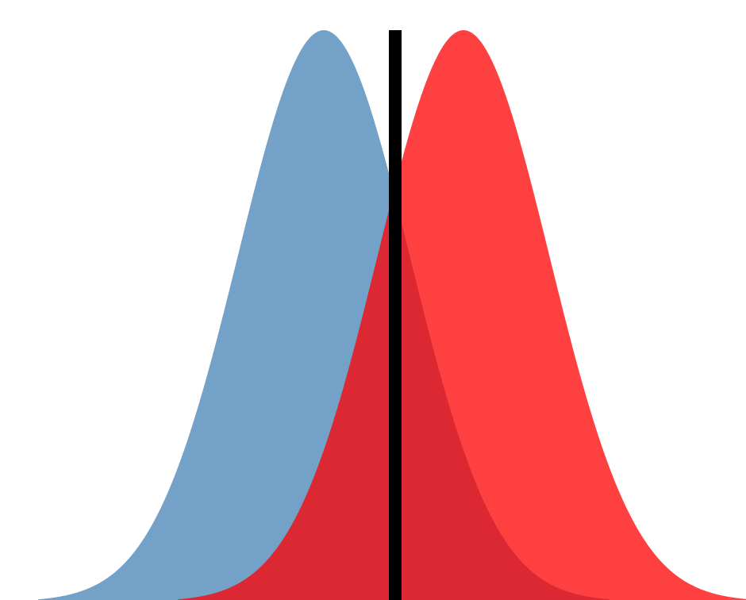
How to assess discrimination?
Suppose our classifier is simply BMI > x.
Both classes (blue = 0 , red = 1) have their own probability distribution of BMI
The choice of X then determines how sensitive or specific our algorithm is.
x
 |  | Predicted
 |  | 1 | 0
Observed | 1 | True Positive (TP) | False Negative (FN)
 | 0 | False Positive (FP) | True Negative (TN)
Probability
TN
TP
FN
FP
True Positive Rate (TPR) = TP / (TP + FN)
False Positive Rate (FPR) = FP / (FP + TN)
BMI
Notes:
Explain following the animation of elements.
We have taken the simple example of BMI > threshold but exactly the same applies to more complex models that consist of many parameters and produce a probability distribution for both classes.
The better we can separate the two distributions the better we are able to discriminate.

Slide 58
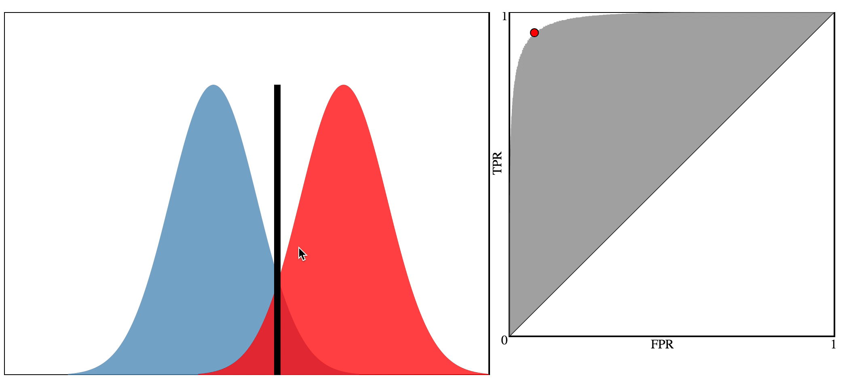
Receiver Operator Characteristic (ROC) curve
Discrimination: Area under curve (AUC)
Notes:
We can plot the FPR against the TPR in a so-called Receiver Operator Curve (ROC)
See slide. Talk through the animation (Press play and let it finish until the full overlap)

Slide 59
Calibration
Agreement between observed and predicted risk
We want a model that has good calibration across the range of predictions (not just on average)
A model is well calibrated if for every 100 individuals given a risk of p% close to p have the event.
For example, if we predict a 12% risk that an atrial fibrillation patient will have a stroke within 365 days, the observed proportion should be approx. 12 strokes per 100 patients

Slide 60
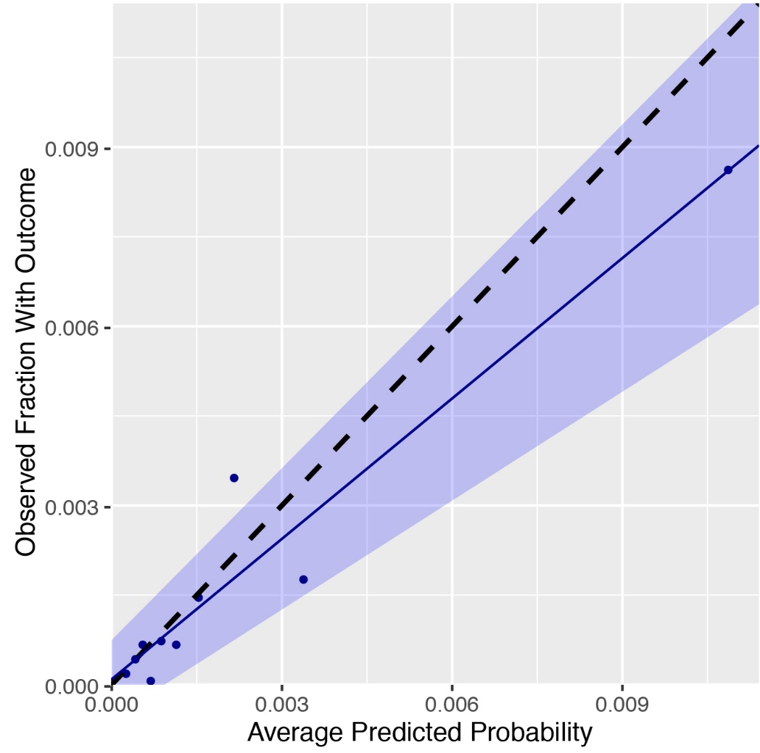
Calibration Assessment
How close is the average predicted probability to the observed fraction with the outcome?
Underestimation
Overestimation
Notes:
Calibration is the second important measure to asses. It determines how close the estimated probabilities are to the observed probabilities. This plot shows the average predicted risk in deciles and the observed Risk in those subsets. Ideally the calibration follows the dotted diagonal line.
A calibration line is fitted through the points and the slope indicates if there is overall a too low (<1) or too high (>1) average predicted risk.

Slide 61

External Validation
Training
Internal Validation
Data Extraction
External Validation
Dissemination
Problem Definition
External validation is performed using
data from multiple populations not
used for training.
Train
Apply
Evaluate
2
Auc2, Cal2
1
Model
3
Auc3, Cal3
4
Auc4, Cal4
Notes:
Clearly internal validation is a necessary component for model training but external validation should be the standard.
Transportability of the models can easily be assessed in the OHDSI data network because of the high level of standardization through the OMOP CDM.
We believe this should be the standard for all predictive modelling development.
This also allows training on each population in turn and evaluate on the others not used for training.

Slide 62
Patient-Level Prediction Roadmap
Evidence
Generation
Evidence
Evaluation
Evidence
Dissemination
Evidence
Generation
Evidence
Dissemination
Evidence
Evaluation
Protocol Sharing
CDM Extractions
Code Sharing
Train / Test split
Standardized Process
Discrimination
Calibration
External Validation
Notes:
Peopl are familiar with evaluation, but there is no standardization.

Slide 63
Dissemination
Training
Internal Validation
Data Extraction
External Validation
Dissemination
Problem Definition
Dissemination of study results should follow the minimum requirements as stated in the Transparent Reporting of a multivariable prediction model for Individual Prognosis Or Diagnosis (TRIPOD) statement ¹.
Internal and external validation
Sharing of full model details
Sharing of all analyses code to allow full reproducibility
Website to share protocol, code, models and results for all databases
¹ Moons, KG et al. Ann Intern Med. 2015;162(1):W1-73
Notes:
See slide.
Dissemination is not only about how to share the results in a publication but also how to share the models etc.

Slide 64
Patient-Level Prediction Roadmap
Evidence
Generation
Evidence
Evaluation
Evidence
Dissemination
Protocol Sharing
CDM Extractions
Code Sharing
Train / Test split
Standardization
Discrimination
Calibration
External Validation
Publications (TRIPOD)
Model sharing
Full transparency

Slide 65
Questions?

Slide 66
Part 3: Prediction in Patients with Pharmaceutically Treated Depression
Notes:
Let’s put all we have discussed until now into practice using real-world data.
I will now show results of the proof of concept study we have performed in patients with Pharmaceutically Treated Depression as introduced in the presentation of Patrick.

Slide 67
Problem definition
Full Patient History
1 Year
Outcome 1/22
First Pharmaceutically Treated Depression
Among patients in 4 different databases, we aim to develop prediction models to predict which patients at a defined moment in time (First Pharmaceutically Treated Depression Event) will experience one out of 22 different outcomes during a time-at-risk (1 year). Prediction is done using all demographics, conditions, and drug use data prior to that moment in time.
Notes:
Let’s make our prediction problem more concrete.
Talk through the slide

Slide 68
Target (T) Cohort Definition
Patients are included in the cohort of interest at the date of the first occurrence of Pharmaceutically Treated Depression if the following inclusion criteria apply:
At least 365 days of history
At least 365 days of follow-up or the occurrence of the outcome of interest
No occurrence of the event prior to the index date
Notes:
See slide.

Slide 69
Setting
Databases
Data extraction
All demographics, conditions, drugs
All 22 outcome cohorts
Training and testing
Time split for training and testing
Transportability for Stroke
Models
Gradient Boosting
Random Forest
Regularized Regression
Outcomes
Acute liver injury
Acute myocardial infarction
Alopecia
Constipation
Decreased libido
Delirium
Diarrhea
Fracture
Gastrointestinal hemhorrage
Hyperprolactinemia
Hyponatremia
Hypotension
Hypothyroidism
Insomnia
Nausea
Open-angle glaucoma
Seizure
Stroke
Suicide and suicidal ideation
Tinnitus
Ventricular arrhythmia and sudden cardiac death
Vertigo
Database | Depression | Stroke
CCAE | 659402 | 1351
MDCD | 79818 | 356
MDCR | 57839 | 874
OPTUM | 363051 | 1183
Database | Depression
CCAE | 659402
MDCD | 79818
MDCR | 57839
OPTUM | 363051
Notes:
Refresh the list of outcomes as introduced by Patrick.
Show the databases and the algorithms.
Click
Because of the large amount of results this is generating I will focus on the results for stroke first on one database and then we will zoom out to all databases, algorithms and all algorithms

Slide 70
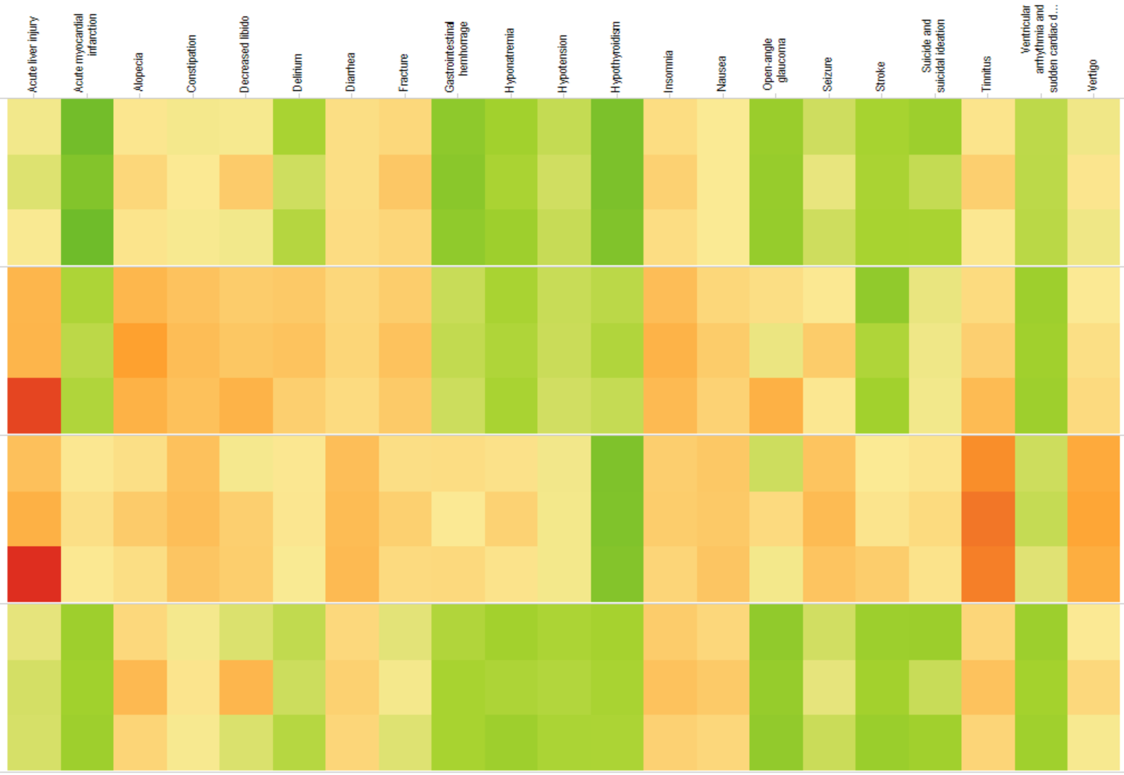
Model Discrimination Stroke
STROKE
AUC
Gradient Boosting
1.00
CCAE
0.90
Random Forest
0.80
Regularized Regression
0.70
0.60
0.50
MDCD
MDCR
OPTUM
Notes:
Let’s now look at the performance of all the algorithms on all the databases for stroke
In this heat map you see the four databases denoted by the panels and in each panel you see the performance of the three models.
We see that the discrimination is quite high over the database except for MDCR.
We also see that the performance of each of the models is quite comparable.

Slide 71
Model Discrimination
Outcomes
AUC
Gradient Boosting
1.00
CCAE
0.90
Random Forest
0.80
Regularized Regression
0.70
0.60
Low performance on MDCR
0.50
MDCD
MDCR
OPTUM
Notes:
Now let’s zoom out to all the outcomes over all the algorithms and all the databases.
We now see a column per outcome and each of the horizontal panels is a database and each row in a panel is an algorithm.
A lot of information in this colourfull picture. Let’s focus on some interesting aspects.
Models perform in general bad on the MDCR database compared to the others, except maybe for Hypothyroid…CHECK NAME. The MDCR databases contains in genarally older patients with more co-morbidities which could mean that it is harder to discriminate.

Slide 72
Model Discrimination
AMI
Diarrhea
Hypothyroidism
Nausea
Stroke
AUC
1.00
CCAE
0.90
0.80
0.70
0.60
0.50
MDCD
Some outcomes we can predict very well some we cannot
MDCR
OPTUM
Notes:
Now let’s zoom out to all the outcomes over all the algorithms and all the databases.
We now see a column per outcome and each of the horizontal panels is a database and each row in a panel is an algorithm.
A lot of information in this colourfull picture. Let’s focus on some interesting aspects.
Models perform in general bad on the MDCR database compared to the others, except maybe for Hypothyroid…CHECK NAME. The Medicare databases contains in genarally older patients with more co-morbidities which could mean that it is harder to discriminate.

Slide 73
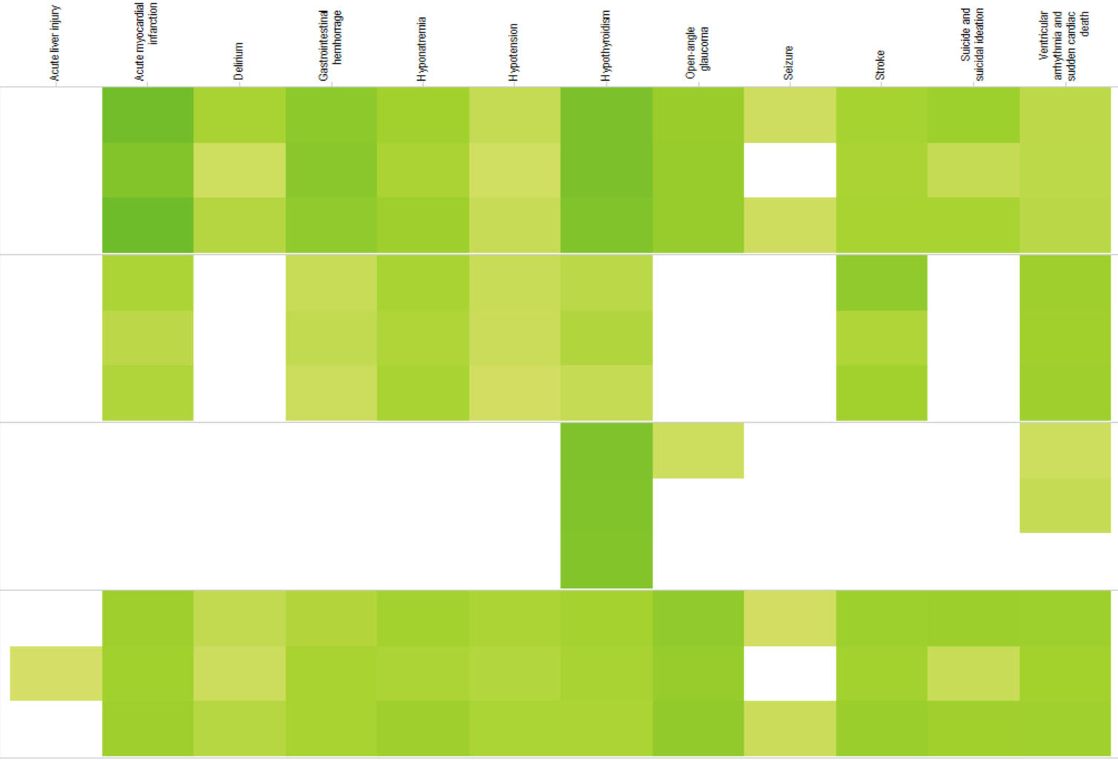
Outcomes with AUC > 0.75
AMI
AUC
CCAE
1.00
0.90
0.80
0.70
0.60
0.50
Best performing is Regularized Regression on CCAE for Acute Myocardial Infarction
AUC = 86.32
MDCD
MDCR
OPTUM
Notes:
If we filter the plot on AUC > 0.75 we see that for about half of the outcomes we are able to achieve good discriminative performance in 3 of the databases.
Myocardial infarction can be predicted best in these patients with an AUC of ??

Slide 74
Model Discrimination
Outcomes
AUC
Gradient Boosting
1.00
CCAE
0.90
Random Forest
0.80
Regularized Regression
0.70
0.60
0.50
MDCD
Discrimination of different algorithms is comparable
MDCR
OPTUM
Notes:
In general the performance is comparable for the three algorithms (small differences in green colour)

Slide 75
Model Discrimination
Outcomes
AUC
Gradient Boosting
1.00
CCAE
0.90
Random Forest
0.80
Regularized Regression
0.70
0.60
0.50
MDCD
But not always!
For open-angle glaucoma Gradient Boosting is better
MDCR
OPTUM
Notes:
However, there are outcomes for which the more complex models do work better. For open-angle glaucome the Gradient Boosting model is working better than than the linear model. It could however well be that this more a feature engineering problem than a model problem. The GBM also includes interactions of the variables. Possibly, if we knew which interactions are important we could add them in the LR model and could get a comparable performance?
How well would other algorithms do that we did not look at? We believe is important to do research on how we can improve the model performance by developing better algorithms or do better feature engineering for example look at temporal patterns, sparse coding etc.

Slide 76
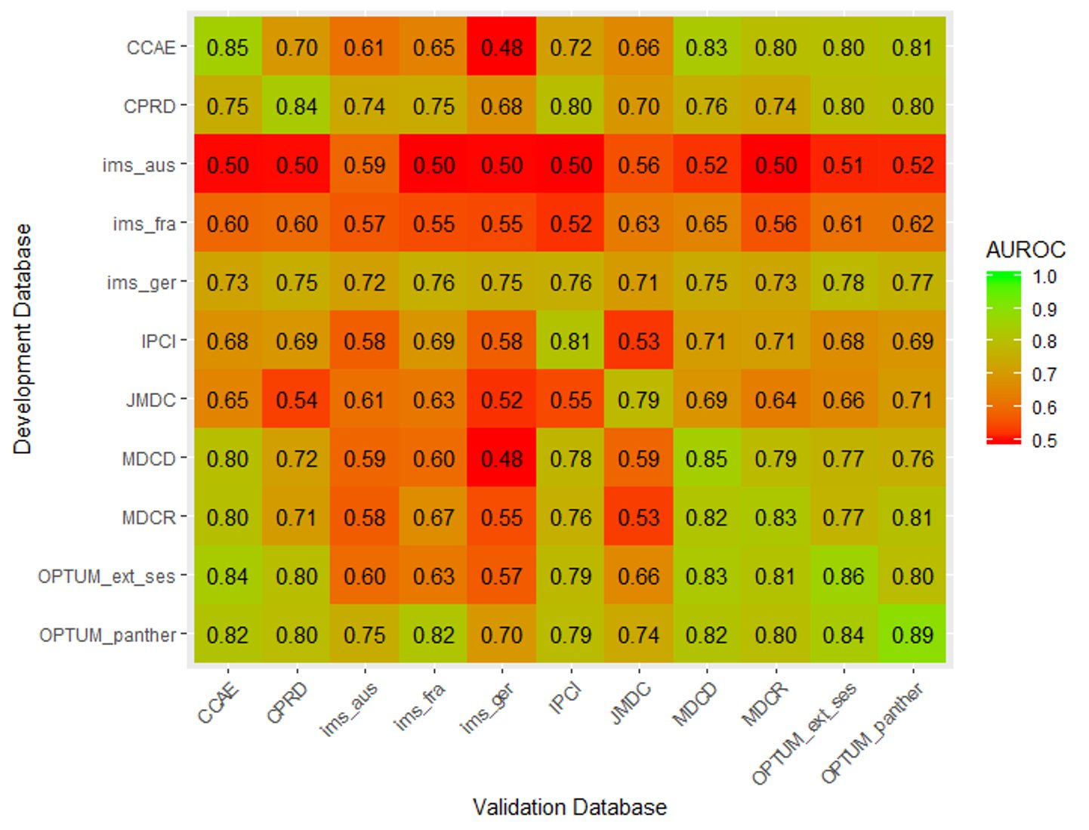
External Validation

Slide 77


What did we achieve so far?
We showed it is feasible to develop large-scale predictive models for all databases converted to the OMOP CDM. This can now be done for any target cohort (T), outcome (O), and time at risk.
Adequate internal validation
Full data driven approach
Dissemination of models and results
Transportability assessment
Impact on clinical decision making
Notes:
Often these studies have methodological issues, for example inadequate training and testing of the model or missing rationale for the model choice.
Almost all these models are trained on a small set of features selected using a knowledge driven approach. We believe it would be better to include all the prior information available in the medical record and let the algorithm select the best for prediction
Dissemination of the model and results is also often suboptimal, for example the full model is not shared which makes it impossible for others to apply the model, or results do not contain the necessary performance measures.
Assessment of portability of the models is often not include in the paper. How well does this model perform on other datasets than used for training.
Only few clinical impact studies have been performed in which the clinical usefulness is assessed. This is a very challenging task.
The result is that relatively few prediction models are really used in clinical practice.

Slide 78
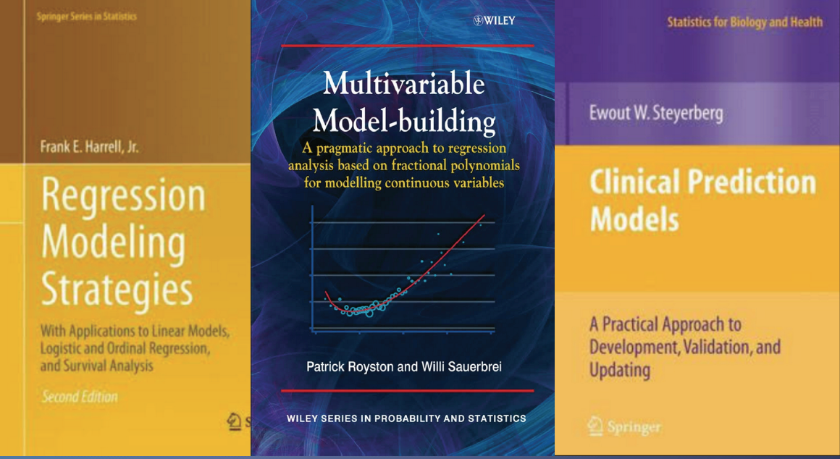

Further Reading if you got very interested!
Phases of Clinical Prediction Modeling BMJ Series 2009
Many good textbooks:

Slide 79

Let’s take a 15 min break

Slide 80
Today’s Agenda
Time | Topic
8:45 – 9:00 | Get settled, get laptops ready
9:00 – 10:00 | Exercise: Selection of prediction problem
10:00 – 10:45 | Presentation: What is Patient-Level Prediction
10:45 – 11:00 | Break
11:00 – 11:45 | Presentation: Learning the OHDSI Patient-Level Prediction Framework
11:45 – 12:30 | Presentation: Overview of the TRIPOD Statement Exercise: Applying TRIPOD to CHADS2
12:30 – 13:15 | Lunch
13:15 – 15:15 | Guided tour through implementing patient-level prediction
15:15 – 15:30 | Break
15:30 – 16:45 | Exercise: Design and implement your own patient-level prediction
16:45 – 17:00 | Lessons Learned and Feedback

Slide 81
Learning The PLP Framework
Understanding the components

Slide 82
Prediction Process
Notes:
Show time/cross sectional plots

Slide 83
Prediction Process
What is our labeled data?
Notes:
Show time/cross sectional plots

Slide 84
Our Data
We have longitudinal data but we need labelled data for prediction…
Disease
Treatment
Outcome
Person ID | Concept ID | Date
1 | 343 | 2016-01-01
1 | 12045 | 2016-01-12
1 | 88466 | 2017-04-05
…
1 | 0945 | 2019-01-23
2 | 343 | 2010-12-03
2 | 635636 | 2010-12-03
2 | 543 | 2010-12-05
…
Conditions
Drugs
Procedures
Measurements
Notes:
Show time/cross sectional plots

Slide 85
Defining Prediction Problem
You need a well defined and clear prediction problem
Considerations:
Is this clinically useful?
Is there a clear timepoint to apply the model?

Slide 86
Prediction Question
In <target population> predict who develop <outcome> during <time-at-risk>
<target population> : The population of patients who you want to apply the model to, e.g., pregnant women, new users of drug X, those newly diagnosed with condition Y
<outcome> : The thing you want to predict, e.g., death, stroke, depression
<time-at-risk> : The period of time you want to predict the outcome occurring relative to the target population index date, e.g., 1 day until 365 days after index

Slide 87
Extracting Labelled Data
The target cohort is key because we need an index date to pivot on… Data before index are used as features and data after index are used to see whether outcome occurs during TAR
Disease
Treatment
Outcome
Conditions
Drugs
Procedures
Measurements
Person time
Baseline time
Follow-up time
0
Notes:
Show time/cross sectional plots

Slide 88
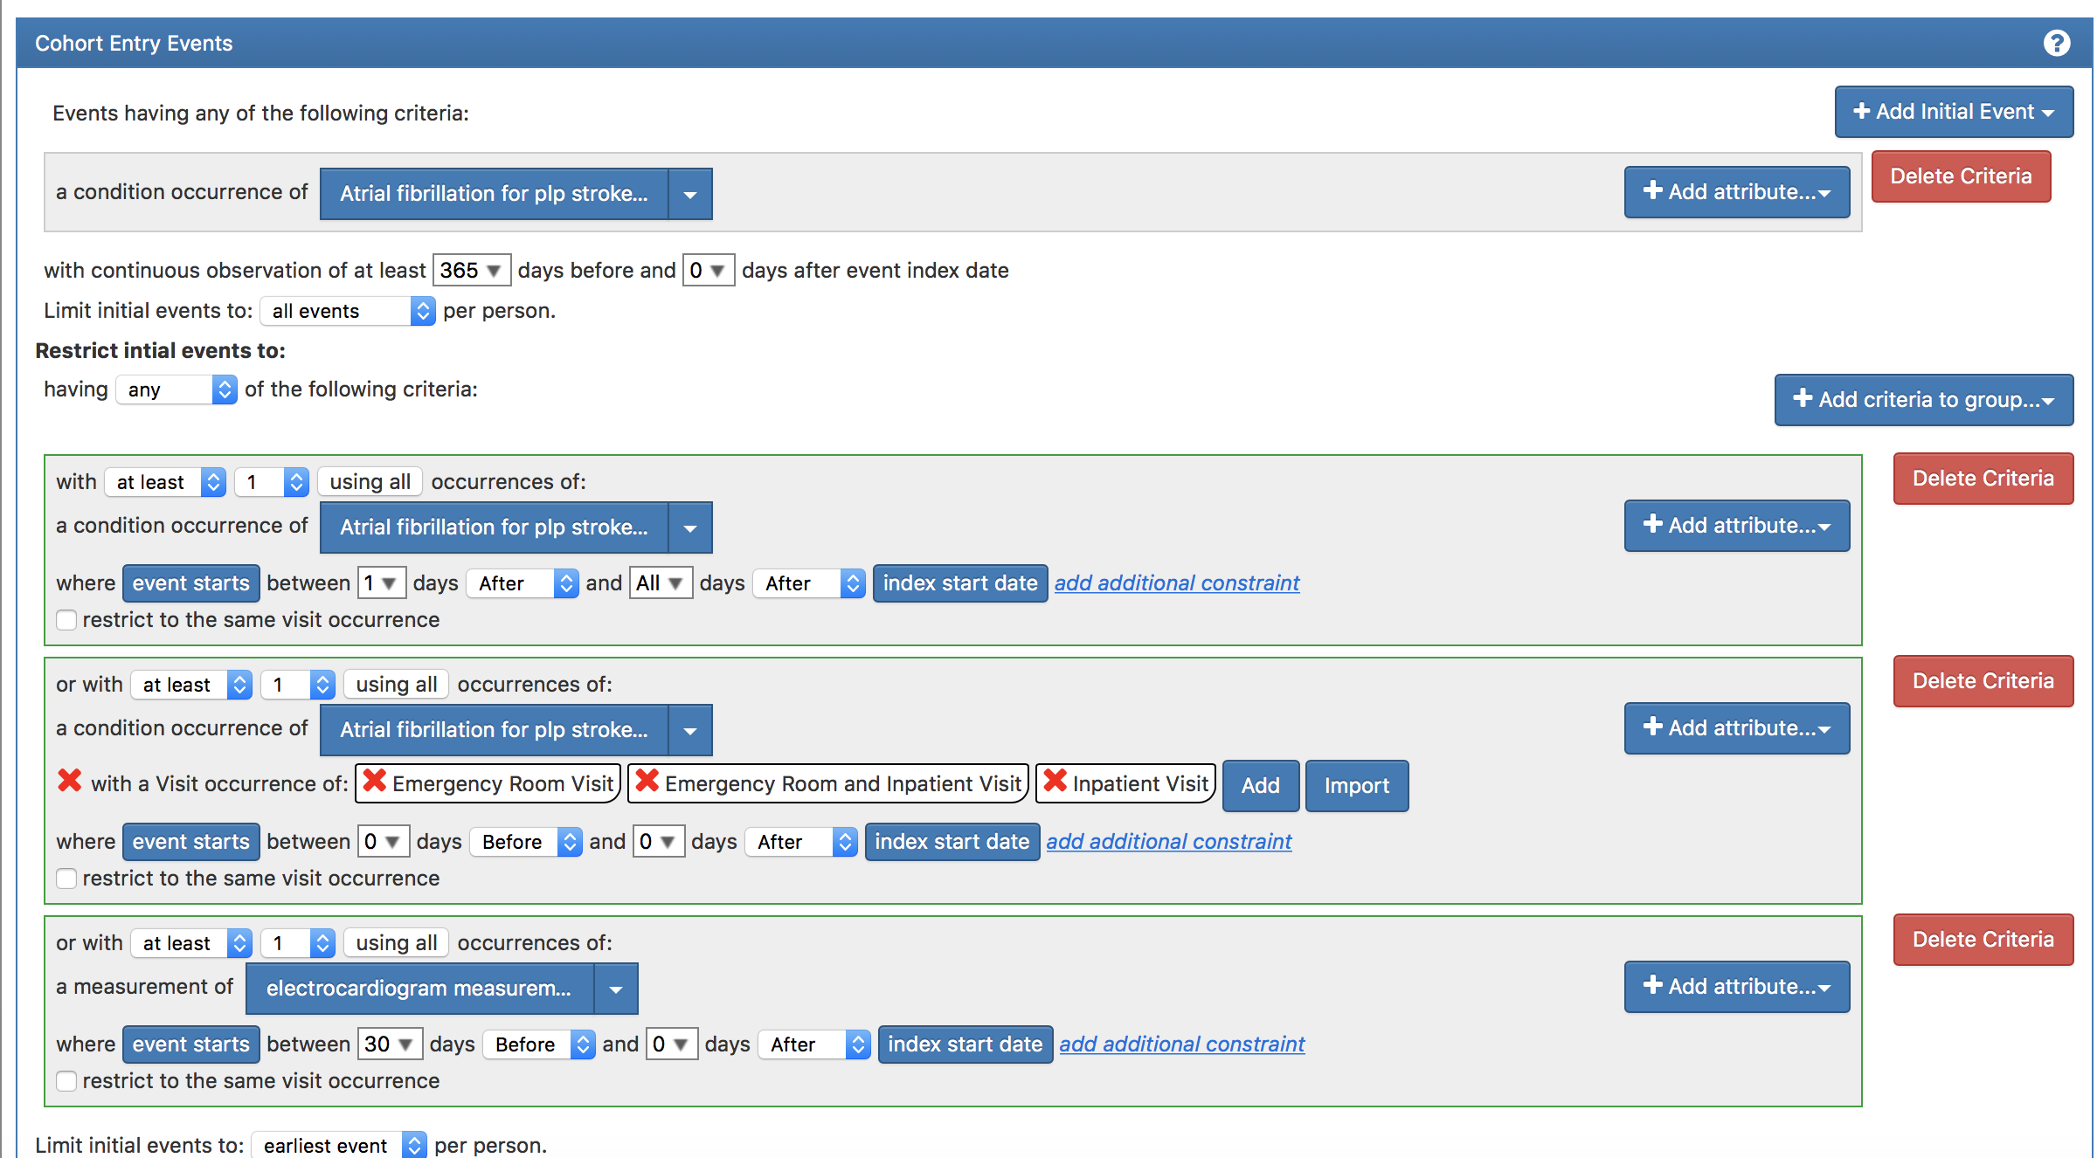
Target Cohort Logic for Atrial Fibrilation
Find first event where patients have 365 days prior observation and:
Two or more atrial fibrillations outpatient records
Or
One atrial fibrillations inpatient/ER record
Or
One atrial fibrillations record with an electrocardiogram
The index (cohort start date) is the date of the first atrial fibrillation record satisfying this

Slide 89
Target Cohort Table for Atrial Fibrilation
A unique identifier for a patient
The cohort the patient belongs to (e.g., 1= atrial fibrillation)
The day a patient enters/exits the cohort – one of these is the index date (e.g., when they have atrial fibrillation)
Subject_id | Cohort_definition_id | Cohort_start_date | Cohort_end_date
3454102 | 1 | 2012-01-02 | 2012-01-01
105454 | 1 | 2012-08-12 | 2012-08-12
105459 | 1 | 2009-05-05 | 2009-05-05
4346356 | 1 | 2011-07-05 | 2011-07-05
342424 | 1 | 2010-01-01 | 2010-01-01
… | … | … | …

Slide 90
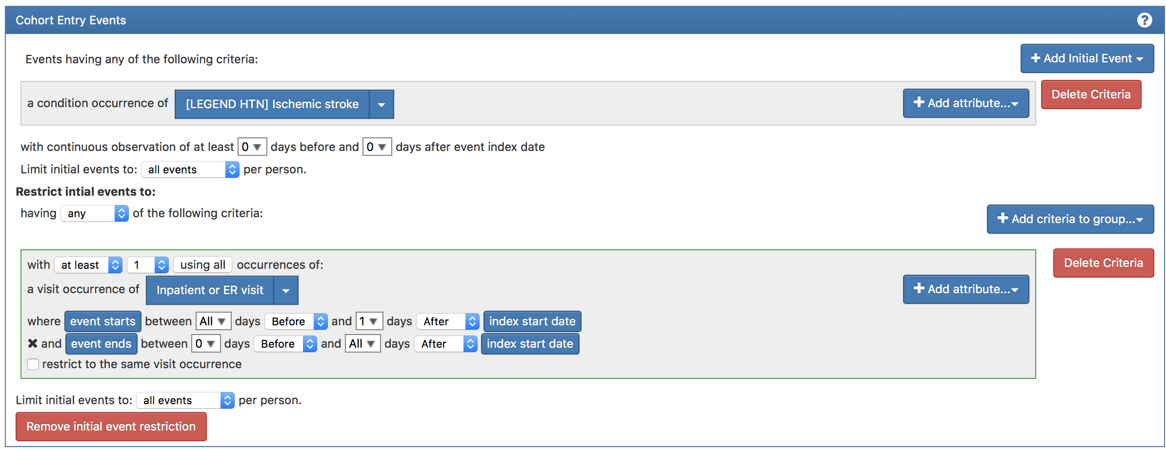
Outcome Cohort Logic for Ischemic Stroke
Find all events of:
Ischemic stroke record within an inpatient or ER visit
The index (outcome start date) is the date of the inpatient ischemic stroke

Slide 91
Outcome Cohort For Ischemic Stroke
A unique identifier for a patient
The cohort the patient belongs to (e.g., 2= ischemic stroke)
The day a patient enters/exits the cohort – one of these is the index date (e.g., when they have stroke)
Subject_id | Cohort_definition_id | Cohort_start_date | Cohort_end_date
4346356 | 2 | 2010-09-12 | 2010-09-12
4346356 | 2 | 2011-08-01 | 2011-08-01
342424 | 2 | 2012-02-01 | 2012-02-01
1009833 | 2 | 2016-04-05 | 2016-04-05
… | … | … | …

Slide 92
Extracting Labelled Data
Baseline
Index
Follow-up
Stroke
Atrial Fib
Stroke
Conditions
For each patient in the Target cohort we can now split their time at the index
Drugs
Procedures
Measurements
Person time
Past used to create covariate
Look for outcome during time-at-risk
Notes:
Show time/cross sectional plots

Slide 93
Extracting Labelled Data
Baseline
Index
Follow-up
Stroke
Atrial Fib
Stroke
Conditions
Drugs
But we need to define the time-at-risk in the follow-up
Procedures
Measurements
Person time
Past used to create covariate
Look for outcome during time-at-risk
Notes:
Show time/cross sectional plots

Slide 94
Extracting Labelled Data
Baseline
Index
Follow-up
Stroke
Atrial Fib
Stroke
Time-at-risk: 1 day from cohort start date until 30 days from cohort start date
Conditions
Drugs
Procedures
Measurements
Person time
Past used to create covariate
Look for outcome during time-at-risk
Notes:
Show time/cross sectional plots

Slide 95
Extracting Labelled Data
Baseline
Index
Follow-up
Stroke
Atrial Fib
Stroke
Time-at-risk: 1 day from cohort start date until 730 days from cohort start date
Conditions
Drugs
Procedures
Measurements
Person time
Past used to create covariate
Look for outcome during time-at-risk
Notes:
Show time/cross sectional plots

Slide 96
Extracting Labelled Data
Baseline
Index
Follow-up
Stroke
Atrial Fib
Stroke
Time-at-risk: 1 day from cohort start date until 365 days from cohort start date
Conditions
Drugs
Procedures
Measurements
Person time
Past used to create covariate
Look for outcome during time-at-risk
Notes:
Show time/cross sectional plots

Slide 97
Extracting Labelled Data
Baseline
Index
Follow-up
Stroke
Atrial Fib
Stroke
Time-at-risk: 1 day from cohort start date until 365 days from cohort start date
Conditions
Drugs
Procedures
Measurements
Person time
Past used to create covariate
Look for outcome during time-at-risk
Condition A | Condition B | … | Drug 1 | …
1 | 0 |  | 0
Outcome
1
Notes:
Show time/cross sectional plots

Slide 98
We have this for many patients
Person 1
Disease
Atrial Fib
Outcome
Person 2
Atrial Fib
Person 3
Disease
Atrial Fib
Person N
Conditions
Atrial Fib
Stroke
Conditions
Drugs
Conditions
Drugs
Procedures
Conditions
Drugs
Procedures
Measurements
Drugs
Procedures
Measurements
Measurements
Person time
Procedures
Measurements
Person time
Baseline time
Follow-up time
0
Person time
Baseline time
Follow-up time
0
Person time
Baseline time
Follow-up time
0
Baseline time
Follow-up time
0

Slide 99
Extracting Labelled Data
Each person corresponds to a row
Labelled classification data
Subject_id | Cohort start date | Has outcome during TAR
3454102 | 2012-01-02 | 1 (Yes)
105454 | 2012-08-12 | 0 (No)
… |  | …
This gives us our labels for each subject!
Notes:
Show time/cross sectional plots

Slide 100
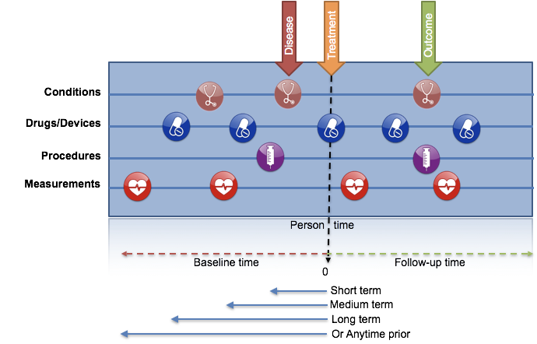
Now Use Baseline to Construct Covariates
Atrial Fib
Stroke
We create standard features using records prior to the target cohort start date (e.g., the atrial fibrillation)

Slide 101
Covariates
Can pick three time periods and anytime prior to index (include index is an option)
Binary indicator variables for conditions, drugs, procedures, measurements and observations
Values for measurements
Can use hierarchy to create binary indicators for a code and all children code (grouped covariates)
Includes record type counts
Includes some common risk scores
Can add custom variables
Notes:
Examples here…

Slide 102
Extracting Labelled Data
We create the covariates using the baseline for each subject
Labelled classification data
Subject_id | Condition A | Condition B | … | Drug N | Has outcome during TAR
3454102 | 1 | 1 | … | 0 | 1 (Yes)
105454 | 1 | 0 | … | 1 | 0 (No)
… | … | … | … | … | …
This gives us our label data for each subject!
Notes:
Show time/cross sectional plots

Slide 103
Population Settings
We have extra inclusion settings in the framework
Do you want to remove people who have the outcome prior (i.e., predict new occurrence of outcome)?
Do you want to only include each person in the target population once?
Do you want a minimum prior observation time (i.e., only include subjects with 3 years or prior records)?
How do you want to deal with people who are lost to follow-up?

Slide 104
Population Settings
We have extra inclusion settings in the framework
Do you want to remove people who have the outcome prior (i.e., predict new occurrence of outcome)?
Do you want to only include each person in the target population once?
Do you want a minimum prior observation time (i.e., only include subjects with 3 years or prior records)?
How do you want to deal with people who are lost to follow-up?

Slide 105
Imaging your cohort looks like this:
Subject_id | Cohort_id | Cohort_start_date | Outcome during TAR | Prior outcome
3454102 | 1 | 2012-01-02 | 0
105454 | 1 | 2012-08-12 | 0
1554 | 1 | 2009-05-05 | 0
56566 | 1 | 2011-07-05 | 0 | Yes (-35 days and -999 days)
4346356 | 1 | 2011-07-05 | 1
342424 | 1 | 2010-01-01 | 1 | Yes (-370 days)
… | … | …

Slide 106
Imaging your cohort looks like this:
Subject_id | Cohort_id | Cohort_start_date | Outcome during TAR | Prior outcome
3454102 | 1 | 2012-01-02 | 0
105454 | 1 | 2012-08-12 | 0
1554 | 1 | 2009-05-05 | 0
56566 | 1 | 2011-07-05 | 0 | Yes (-35 days and -999 days)
4346356 | 1 | 2011-07-05 | 1
342424 | 1 | 2010-01-01 | 1 | Yes (-370 days)
… | … | …
Remove patients who have observed the outcome prior to cohort entry? [YES]
How many days to look back from cohort entry for the outcome? [99999] days prior to cohort start

Slide 107
Imaging your cohort looks like this:
Subject_id | Cohort_id | Cohort_start_date | Outcome during TAR | Prior outcome
3454102 | 1 | 2012-01-02 | 0
105454 | 1 | 2012-08-12 | 0
1554 | 1 | 2009-05-05 | 0
56566 | 1 | 2011-07-05 | 0 | Yes (-35 days and -999 days)
4346356 | 1 | 2011-07-05 | 1
342424 | 1 | 2010-01-01 | 1 | Yes (-370 days)
… | … | …
Remove patients who have observed the outcome prior to cohort entry? [YES]
How many days to look back from cohort entry for the outcome? [365] days prior to cohort start

Slide 108
Imaging your cohort looks like this:
Subject_id | Cohort_id | Cohort_start_date | Outcome during TAR | Prior outcome
3454102 | 1 | 2012-01-02 | 0
105454 | 1 | 2012-08-12 | 0
1554 | 1 | 2009-05-05 | 0
56566 | 1 | 2011-07-05 | 0 | Yes (-35 days and -999 days)
4346356 | 1 | 2011-07-05 | 1
342424 | 1 | 2010-01-01 | 1 | Yes (-370 days)
… | … | …
Remove patients who have observed the outcome prior to cohort entry? [No]

Slide 109
Population Settings
We have extra inclusion settings in the framework
Do you want to remove people who have the outcome prior (i.e., predict new occurrence of outcome)?
Do you want to only include each person in the target population once?
Do you want a minimum prior observation time (i.e., only include subjects with 3 years or prior records)?
How do you want to deal with people who are lost to follow-up?

Slide 110
Imaging your cohort looks like this:
Subject_id | Cohort_id | Cohort_start_date | Outcome during TAR
3454102 | 1 | 2012-01-02 | 0
105454 | 1 | 2012-08-12 | 0
105454 | 1 | 2013-10-04 | 0
1554 | 1 | 2009-05-05 | 0
56566 | 1 | 2011-07-05 | 0
4346356 | 1 | 2011-07-05 | 1
342424 | 1 | 2010-01-01 | 1
… | … | …

Slide 111
Imaging your cohort looks like this:
Subject_id | Cohort_id | Cohort_start_date | Outcome during TAR
3454102 | 1 | 2012-01-02 | 0
105454 | 1 | 2012-08-12 | 0
105454 | 1 | 2013-10-04 | 0
1554 | 1 | 2009-05-05 | 0
56566 | 1 | 2011-07-05 | 0
4346356 | 1 | 2011-07-05 | 1
342424 | 1 | 2010-01-01 | 1
… | … | …
Should only the first exposure per subject be included? [YES]

Slide 112
Imaging your cohort looks like this:
Subject_id | Cohort_id | Cohort_start_date | Outcome during TAR
3454102 | 1 | 2012-01-02 | 0
105454 | 1 | 2012-08-12 | 0
105454 | 1 | 2013-10-04 | 0
1554 | 1 | 2009-05-05 | 0
56566 | 1 | 2011-07-05 | 0
4346356 | 1 | 2011-07-05 | 1
342424 | 1 | 2010-01-01 | 1
… | … | …
Should only the first exposure per subject be included? [No]

Slide 113
Population Settings
We have extra inclusion settings in the framework
Do you want to remove people who have the outcome prior (i.e., predict new occurrence of outcome)?
Do you want to only include each person in the target population once?
Do you want a minimum prior observation time (i.e., only include subjects with 3 years or prior records)?
How do you want to deal with people who are lost to follow-up?

Slide 114
Imaging your cohort looks like this:
Subject_id | Cohort_id | Cohort_start_date | Outcome during TAR | Prior observation
3454102 | 1 | 2012-01-02 | 0 | 366
105454 | 1 | 2012-08-12 | 0 | 2009
1554 | 1 | 2009-05-05 | 0 | 1098
56566 | 1 | 2011-07-05 | 0 | 365
4346356 | 1 | 2011-07-05 | 1 | 4056
342424 | 1 | 2010-01-01 | 1 | 588
… | … | …

Slide 115
Imaging your cohort looks like this:
Subject_id | Cohort_id | Cohort_start_date | Outcome during TAR | Prior observation
3454102 | 1 | 2012-01-02 | 0 | 366
105454 | 1 | 2012-08-12 | 0 | 2009
1554 | 1 | 2009-05-05 | 0 | 1098
56566 | 1 | 2011-07-05 | 0 | 365
4346356 | 1 | 2011-07-05 | 1 | 4056
342424 | 1 | 2010-01-01 | 1 | 588
… | … | …
Minimum lookback period applied to target cohort: [730]

Slide 116
Imaging your cohort looks like this:
Subject_id | Cohort_id | Cohort_start_date | Outcome during TAR | Prior observation
3454102 | 1 | 2012-01-02 | 0 | 366
105454 | 1 | 2012-08-12 | 0 | 2009
1554 | 1 | 2009-05-05 | 0 | 1098
56566 | 1 | 2011-07-05 | 0 | 365
4346356 | 1 | 2011-07-05 | 1 | 4056
342424 | 1 | 2010-01-01 | 1 | 588
… | … | …
Minimum lookback period applied to target cohort: [1200]

Slide 117
Imaging your cohort looks like this:
Subject_id | Cohort_id | Cohort_start_date | Outcome during TAR | Prior observation
3454102 | 1 | 2012-01-02 | 0 | 366
105454 | 1 | 2012-08-12 | 0 | 2009
1554 | 1 | 2009-05-05 | 0 | 1098
56566 | 1 | 2011-07-05 | 0 | 365
4346356 | 1 | 2011-07-05 | 1 | 4056
342424 | 1 | 2010-01-01 | 1 | 588
… | … | …
Minimum lookback period applied to target cohort: [365]

Slide 118
Population Settings
We have extra inclusion settings in the framework
Do you want to remove people who have the outcome prior (i.e., predict new occurrence of outcome)?
Do you want to only include each person in the target population once?
Do you want a minimum prior observation time (i.e., only include subjects with 3 years or prior records)?
How do you want to deal with people who are lost to follow-up?

Slide 119
Imaging your cohort looks like this:
TAR (time-at-risk) is 1 day to 365 days after cohort start date
Subject_id | Cohort_id | Cohort_start_date | Outcome during TAR | Follow-up observation
3454102 | 1 | 2012-01-02 | 0 | 50
105454 | 1 | 2012-08-12 | 0 | 1082
1554 | 1 | 2009-05-05 | 0 | 366
56566 | 1 | 2011-07-05 | 0 | 480
4346356 | 1 | 2011-07-05 | 1 | 40
342424 | 1 | 2010-01-01 | 1 | 500
… | … | …

Slide 120
Imaging your cohort looks like this:
TAR (time-at-risk) is 1 day to 365 days after cohort start date
Subject_id | Cohort_id | Cohort_start_date | Outcome during TAR | Follow-up observation
3454102 | 1 | 2012-01-02 | 0 | 50
105454 | 1 | 2012-08-12 | 0 | 1082
1554 | 1 | 2009-05-05 | 0 | 366
56566 | 1 | 2011-07-05 | 0 | 480
4346356 | 1 | 2011-07-05 | 1 | 40
342424 | 1 | 2010-01-01 | 1 | 500
… | … | …
Should subjects without time at risk be removed? [YES]
Minimum time at risk: [364] days
Include people with outcomes who are not observed for the whole at risk period? [NO]

Slide 121
Imaging your cohort looks like this:
TAR (time-at-risk) is 1 day to 365 days after cohort start date
Subject_id | Cohort_id | Cohort_start_date | Outcome during TAR | Follow-up observation
3454102 | 1 | 2012-01-02 | 0 | 50
105454 | 1 | 2012-08-12 | 0 | 1082
1554 | 1 | 2009-05-05 | 0 | 366
56566 | 1 | 2011-07-05 | 0 | 480
4346356 | 1 | 2011-07-05 | 1 | 40
342424 | 1 | 2010-01-01 | 1 | 500
… | … | …
Should subjects without time at risk be removed? [YES]
Minimum time at risk: [364] days
Include people with outcomes who are not observed for the whole at risk period? [YES]

Slide 122
Imaging your cohort looks like this:
TAR (time-at-risk) is 1 day to 365 days after cohort start date
Subject_id | Cohort_id | Cohort_start_date | Outcome during TAR | Follow-up observation
3454102 | 1 | 2012-01-02 | 0 | 50
105454 | 1 | 2012-08-12 | 0 | 1082
1554 | 1 | 2009-05-05 | 0 | 366
56566 | 1 | 2011-07-05 | 0 | 480
4346356 | 1 | 2011-07-05 | 1 | 40
342424 | 1 | 2010-01-01 | 1 | 500
… | … | …
Should subjects without time at risk be removed? [No]
Minimum time at risk: [1] days
Include people with outcomes who are not observed for the whole at risk period? [No]

Slide 123
Summary:
Need to define prediction problem
Need to define the target population and outcome cohorts
Need to specify covariate settings
Need to specify population settings – this modifies target population and creates labels

Slide 124
Prediction Process
Model Development Settings
Notes:
Show time/cross sectional plots

Slide 125
Train/Test Data Settings
Train/Test %
e.g., 75/25
Split Seed
e.g., 1
Split type
e.g., time or person
Notes:
Add visulistion of time split vs random split

Slide 126
Training Classifier
Learns to map covariates to class
Effectively about learning a decision boundary that partitions the two classes
Different classifiers lead to different decisions boundaries

Slide 127
Training Settings
Select the machine learning models that will be trained
Define the hyper-parameter search strategy

Slide 128








Library of classifiers built in

Slide 129
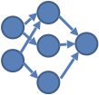
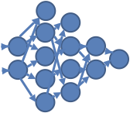
What are hyper-parameters?
They control the complexity of a model
E.g., if we wanted to fit a neural network the topology of the network defines the complexity of the model (few layers and a small number of nodes = more simple)

Slide 130
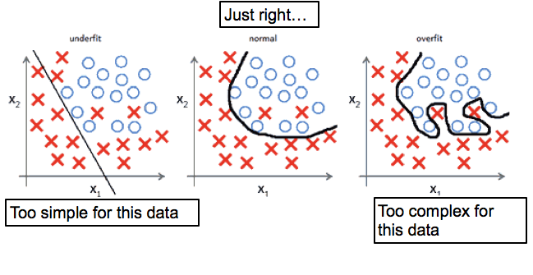
Over vs Under fitting

Slide 131
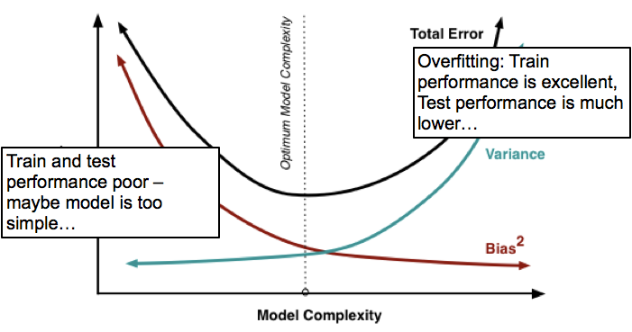
Over vs Under fitting

Slide 132
Summary:
We suggest trying multiple classifiers
We have a large library of classifiers but you can also add custom ones
We have default hyper-parameter grid searches but you can expand this

Slide 133
Prediction Process
Model Evaluation
Notes:
Show time/cross sectional plots

Slide 134
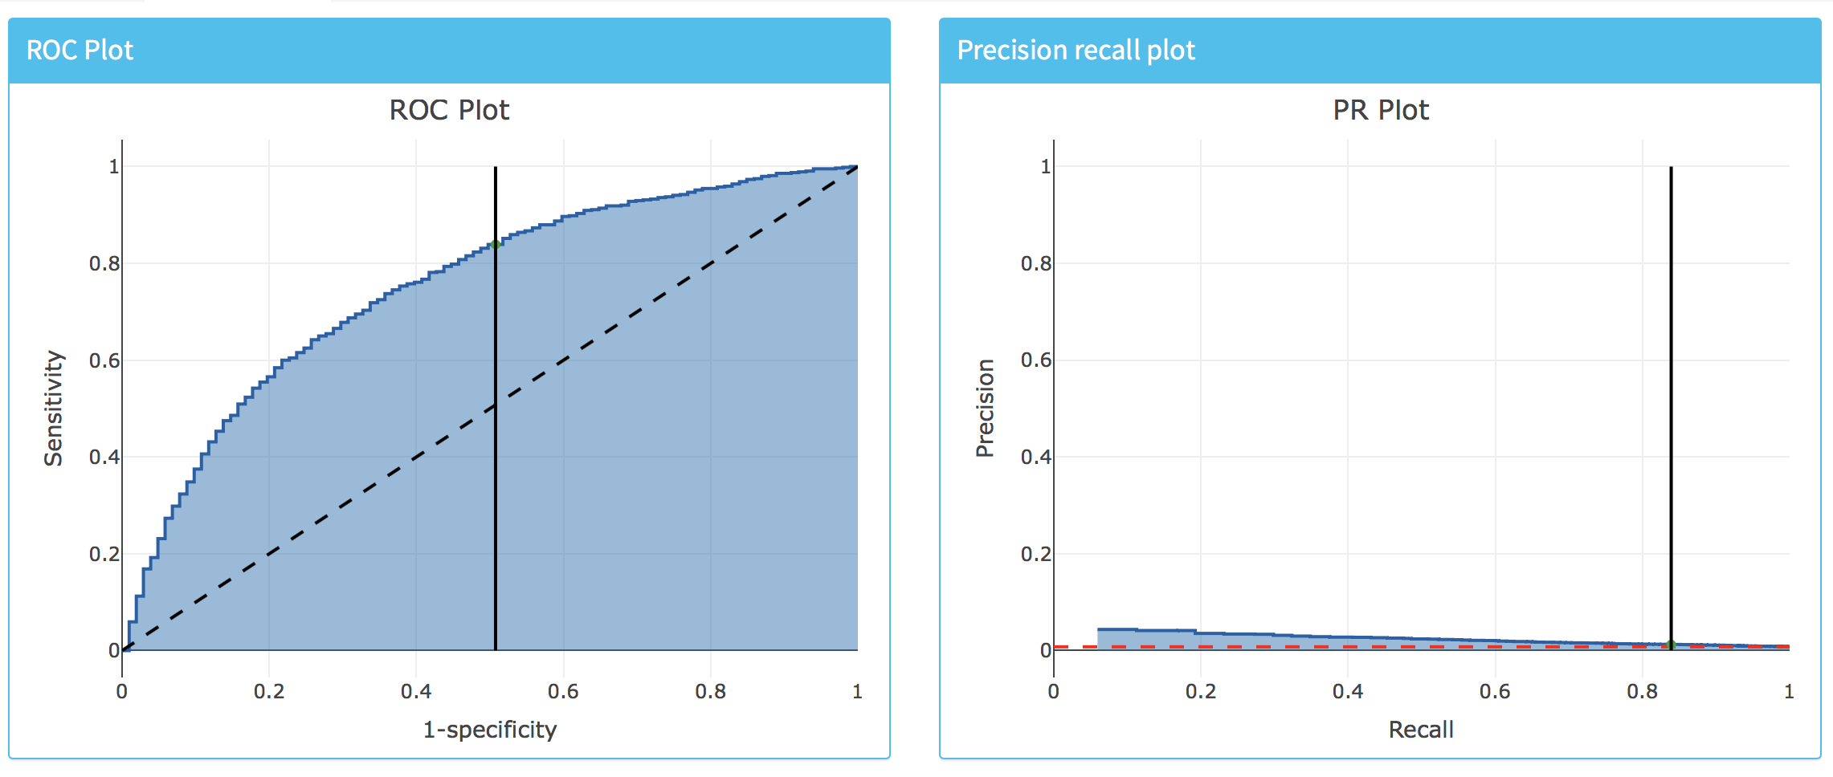
Metrics/Plots

Slide 135
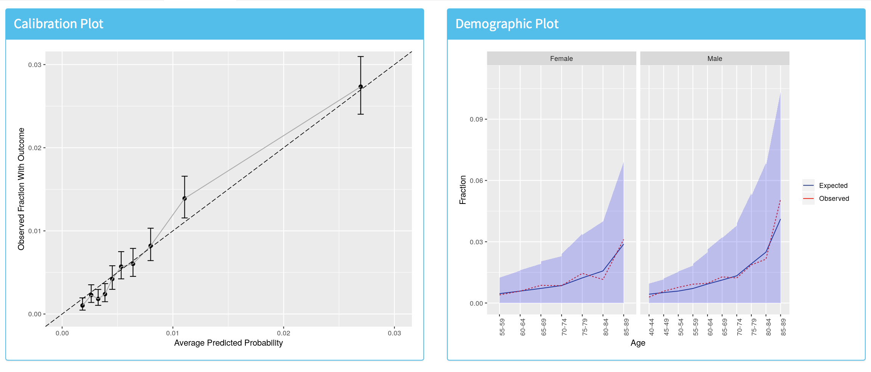
View Interactively via Shiny

Slide 136
Demo: Using Atlas to design a PLP study
How to add Target and Outcome cohorts
How to define population settings
How to define covariate settings
How to define model settings
How to save/load/copy/delete PLP analysis
How to download R package for running study

Slide 137
Demo: Building the R package
How to open the R package in R studio
Details about files to edit
How to build the package
How to run the package

Slide 138
Demo: Viewing the Shiny App
How to view results interactively
How to view settings
How to view performance
How to view model
How to view log

Slide 139
Demo: Creating the validation package and adding to github
How to create the validation package
How to add a package to github for external validation

Slide 140
Demo: Creating the journal paper template
How to convert the results into a template journal paper document

Slide 141
Questions?

Slide 142
Today’s Agenda
Time | Topic
8:45 – 9:00 | Get settled, get laptops ready
9:00 – 10:00 | Exercise: Selection of prediction problem
10:00 – 10:45 | Presentation: What is Patient-Level Prediction
10:45 – 11:00 | Break
11:00 – 11:45 | Presentation: Learning the OHDSI Patient-Level Prediction Framework
11:45 – 12:30 | Presentation: Overview of the TRIPOD Statement Exercise: Applying TRIPOD to CHADS2
12:30 – 13:15 | Lunch
13:15 – 15:15 | Guided tour through implementing patient-level prediction
15:15 – 15:30 | Break
15:30 – 16:45 | Exercise: Design and implement your own patient-level prediction
16:45 – 17:00 | Lessons Learned and Feedback

Slide 143
Transparent Reporting of a multivariable prediction model for Individual Prognosis Or Diagnosis (TRIPOD)
Ross Williams
Erasmus MC

Slide 144
Agenda
Basics of good reporting for prediction models
Review of the TRIPOD Statement
Small group discussion of sample paper
Large group summary of small group findings

Slide 145

Requirements for clinical implementation
Clinical setting
Clinician should be able to identify for who, predicting what, in what time-at-risk
Evidence of performance
Well calibrated?
Good discrimination?

Slide 146
Requirements for clinical implementation
Most models reported in the literature do not provide enough information to impact clinical practice

Slide 147
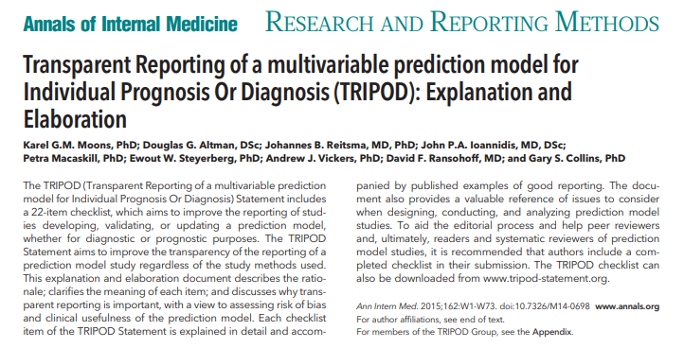
Developed by 25+ member committee of prediction modeling experts
Reduced from 76 to 22 items
https://www.tripod-statement.org/

Slide 148
1 Title
Concise summary of the model
“Development and validation of a clinical score to estimate the probability of coronary artery disease in men and women presenting with suspected coronary disease”

Slide 149
3 Background and Objectives
What was the goal for developing this model?
“The aim of this study was to develop and validate a clinical prediction rule in women presenting with breast symptoms, so that a more evidence based approach to referral—which would include urgent referral under the 2 week rule—could be implemented as part of clinical practice guidance.”

Slide 150
4 Methods - Source of Data
Gives an indication of applicability and quality of the data
“The population based sample used for this report included 2489 men and 2856 women 30 to 74 years old at the time of their Framingham Heart Study examination in 1971 to 1974. Participants attended either the 11th examination of the original Framingham cohort or the initial examination of the Framingham Offspring Study. Similar research protocols were used in each study, and persons with overt coronary heart disease at the baseline examination were excluded.”

Slide 151
6 Methods- Outcome
What was predicted and how was it measured?
“Breast Cancer Ascertainment: Incident diagnoses of breast cancer were ascertained by self-report on biennial follow up questionnaires from 1997 to 2005. We learned of deaths from family members, the US Postal Service, and the National Death Index. We identified 1084 incident breast cancers, and 1007 (93%) were confirmed by medical record or by cancer registry data from 24 states in which 96% of participants resided at baseline.”

Slide 152
7 Methods- Predictors
What was used to inform the model? When was the data collected?
“The following data were extracted for each patient: gender, aspartate aminotransferase in IU/L, alanine aminotransferase in IU/L, aspartate aminotransferase/alanine aminotransferase ratio, total bilirubin (mg/dl), albumin (g/dl), transferrin saturation (%), mean corpuscular volume (μm3), platelet count ( × 103/mm3), and prothrombin time(s). . . . All laboratory tests were performed within 90 days before liver biopsy. In the case of repeated test, the results closest to the time of the biopsy were used. No data obtained after the biopsy were used.

Slide 153
10 Methods - Statistics
What type of model was used and how was performance assessed?
“We used the Cox proportional hazards model in the derivation dataset to estimate the coefficients associated with each potential risk factor [predictor] for the first ever recorded diagnosis of cardiovascular disease for men and women separately.”
“We assessed the predictive performance of the QRISK2- 2011 risk score on the THIN cohort by examining measures of calibration and discrimination… Calibration of the risk score predictions was assessed by plotting observed proportions versus predicted probabilities and by calculating the calibration slope… Discrimination … quantified by calculating the area under the receiver operating characteristic curve statistic; a value of 0.5 represents chance and 1 represents perfect discrimination.”

Slide 154
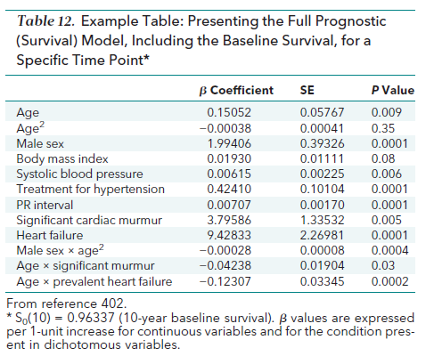
15 Results – Model Specification
What were the predictors and how were they used to inform the final prediction?

Slide 155
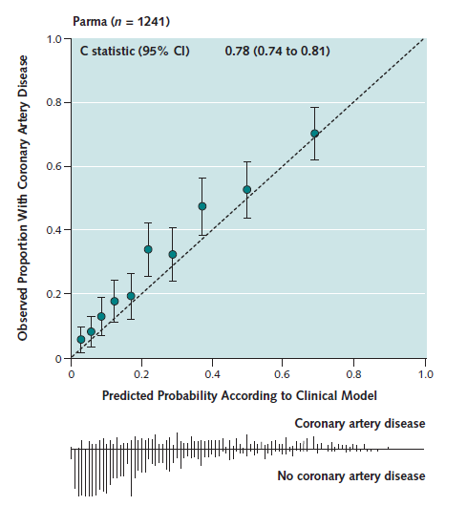
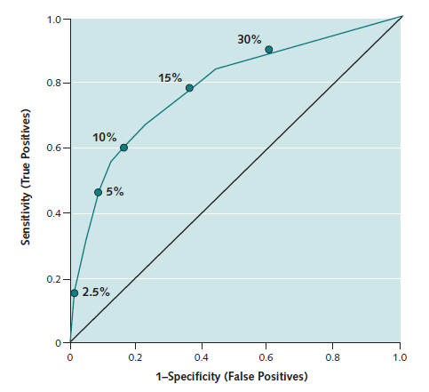
16 Results - Performance
How well did the model perform based on the specified metrics?

Slide 156
Small Group Discussion
Review “Validation of Clinical Classification Schemes for Predicting Stroke Results From the National Registry of Atrial Fibrillation” Gage et al.
Group assignment for filling in the TRIPOD table
Grade each item:
A: completely fulfills the requirement
C: partially fulfills the requirement
F: does not fulfill the requirement
Take about 20 minutes

Slide 157
Quiz time!
All questions framed as whether the paper we read meets one specific part of the Tripod statement
The quiz consists of:
10 multiple choice questions
The faster you answer correctly, the better your score
There is a prize…

Slide 158

Online training environment
We will be working in R Studio and Atlas:
RStudio:
https://rstudio.plp.ohdsitutorials.amazingawsdemos.com/
Atlas:
https://plp.ohdsitutorials.amazingawsdemos.com/
Username: userX (X you can find on agenda)
Password: Password1
Please use Chrome for the exercises.

Slide 159

Lunch Time

Slide 160
Today’s Agenda
Time | Topic
8:45 – 9:00 | Get settled, get laptops ready
9:00 – 10:00 | Exercise: Selection of prediction problem
10:00 – 10:45 | Presentation: What is Patient-Level Prediction
10:45 – 11:00 | Break
11:00 – 11:45 | Presentation: Learning the OHDSI Patient-Level Prediction Framework
11:45 – 12:30 | Presentation: Overview of the TRIPOD Statement Exercise: Applying TRIPOD to CHADS2
12:30 – 13:15 | Lunch
13:15 – 15:15 | Guided tour through implementing patient-level prediction
15:15 – 15:30 | Break
15:30 – 16:45 | Exercise: Design and implement your own patient-level prediction
16:45 – 17:00 | Lessons Learned and Feedback

Slide 161
Exercise: Guided tour through implementing patient-level prediction

Slide 162

Task (Modified CHADS2 model)
In target population (PLP training: T : patients newly diagnosed with Atrial fibrillation) predict who will develop outcome (PLP training: O - hospitalized ischemic stroke events) during the period from 0 days from cohort start date to 1000 days.

Slide 163
Example
We implemented three models in OPTUM for the prediction problem:
CHAD2 model
PLP model using 5 CHAD2 variables (and descendants)
PLP model using all variables

Slide 164
DEMO

Slide 165
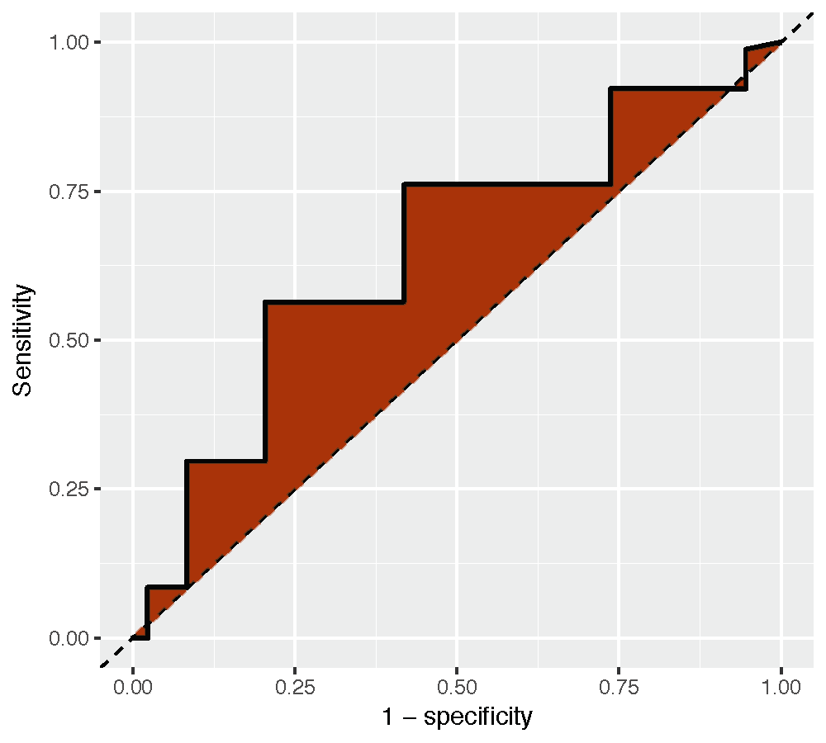
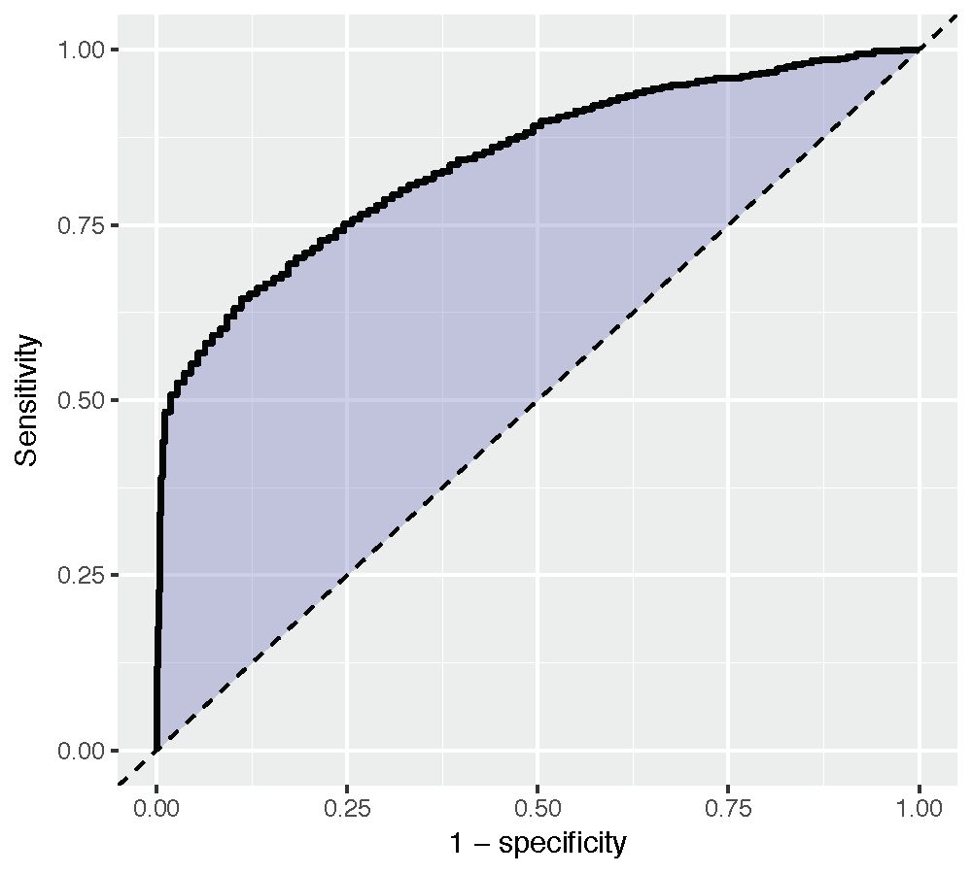
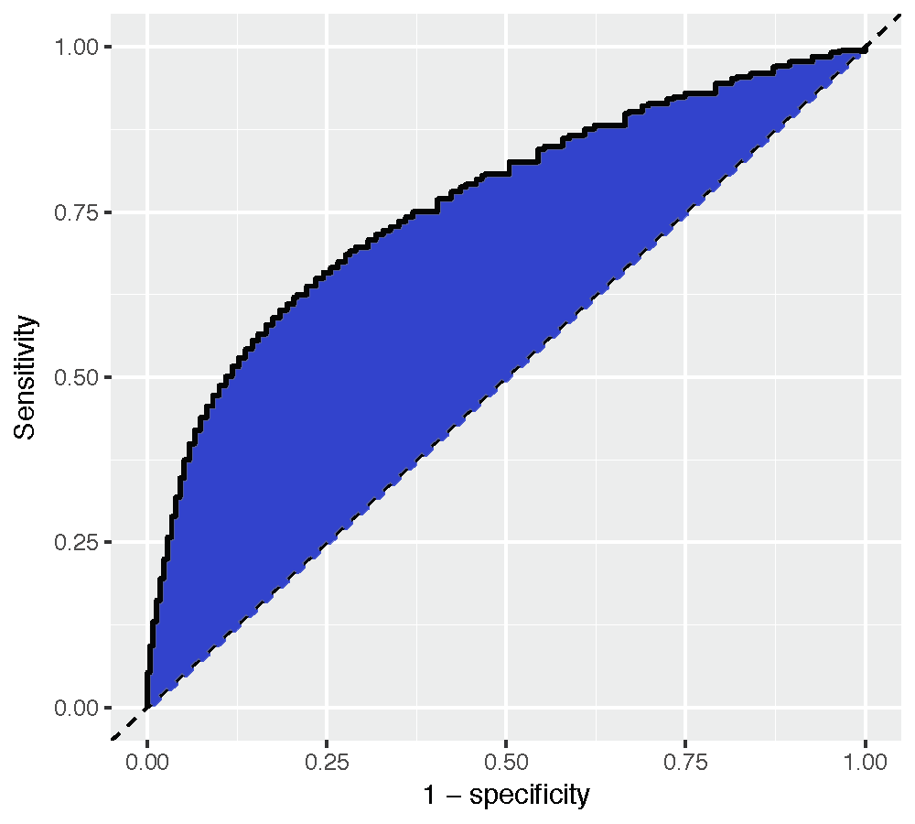
Predicting Stroke in Patients with Atrial Fibrillation: OPTUM results
AUC
CHADS₂
0.72
CHADS₂ variables
0.76
0.82
All variables

Slide 166
Let’s take a 15 min break

Slide 167
Today’s Agenda
Time | Topic
8:45 – 9:00 | Get settled, get laptops ready
9:00 – 10:00 | Exercise: Selection of prediction problem
10:00 – 10:45 | Presentation: What is Patient-Level Prediction
10:45 – 11:00 | Break
11:00 – 11:45 | Presentation: Learning the OHDSI Patient-Level Prediction Framework
11:45 – 12:30 | Presentation: Overview of the TRIPOD Statement Exercise: Applying TRIPOD to CHADS2
12:30 – 13:15 | Lunch
13:15 – 15:15 | Guided tour through implementing patient-level prediction
15:15 – 15:30 | Break
15:30 – 16:45 | Exercise: Design and implement your own patient-level prediction
16:45 – 17:00 | Lessons Learned and Feedback

Slide 168
Exercise: Design and implement your own patient-level prediction

Slide 169
Exercise
Read the Patient-Level Prediction Vignette
You can define new cohorts in Atlas or use those that are there
Option 1: Make a study package through Atlas
Option 2: Make your own script by following the vignette

Slide 170
Things to Explore
What is the effect of the length of the time-at-risk period on performance?
What is the difference in performance of the algorithms?
Hints:
sample your cohorts to max 10.000 patients to improve speed.
start with regularized regression.

Slide 171
Today’s Agenda
Time | Topic
8:45 – 9:00 | Get settled, get laptops ready
9:00 – 10:00 | Exercise: Selection of prediction problem
10:00 – 10:45 | Presentation: What is Patient-Level Prediction
10:45 – 11:00 | Break
11:00 – 11:45 | Presentation: Learning the OHDSI Patient-Level Prediction Framework
11:45 – 12:30 | Presentation: Overview of the TRIPOD Statement Exercise: Applying TRIPOD to CHADS2
12:30 – 13:15 | Lunch
13:15 – 15:15 | Guided tour through implementing patient-level prediction
15:15 – 15:30 | Break
15:30 – 16:45 | Exercise: Design and implement your own patient-level prediction
16:45 – 17:00 | Lessons Learned and Feedback

Slide 172
Lessons learned and feedback

Slide 173
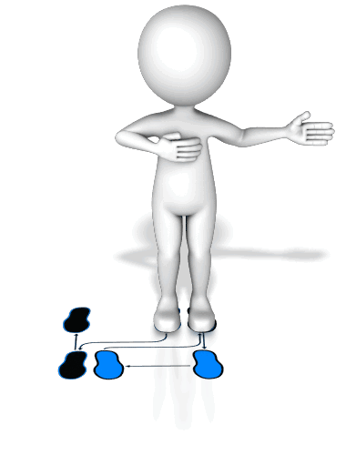

Lessons Learned
Learned the PLP Dance
Educated Fortune Teller

Slide 174

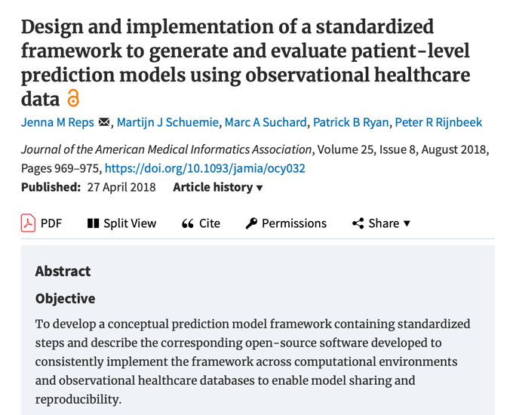
What’s Next?
When you write your JAMA publication;
Follow the TRIPOD Statement.
Cite our work:
R-package
www.github.com/OHDSI/PatientLevelPrediction
Vignettes
Videos
Online training material
Book-of-OHDSI https://ohdsi.github.io/TheBookOfOhdsi/
Study Results
www.data.ohdsi.org

Slide 175
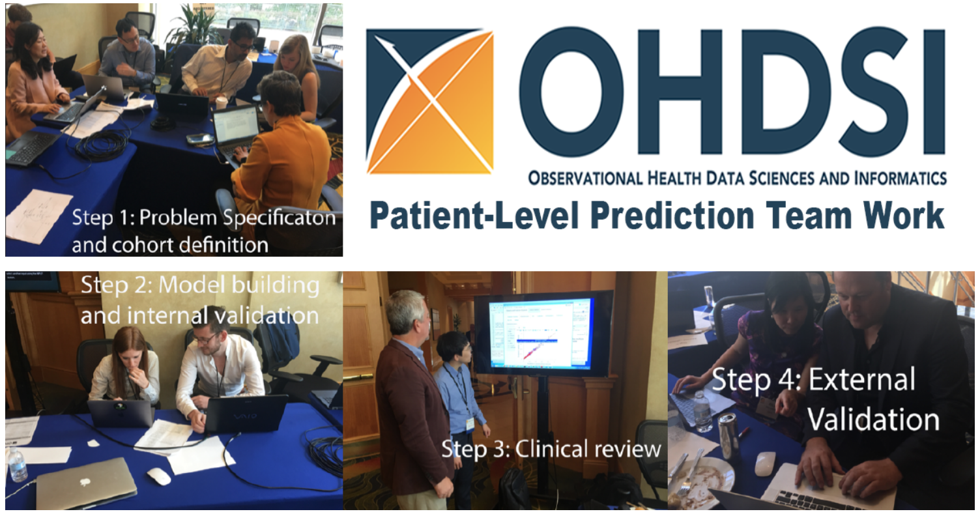
Large-Scale Patient-Level Prediction not the Future!

Slide 176

Join the PLP Community
Monthly meetings of PLP WG
Researchers Forum
(tag patientprediction)
Become an active developer: add your own algorithms and other features

Slide 177


Continuation of the PLP Journey
Scale up
Increase the number of database
Increase the number of cohorts at risk
Increase the number of outcomes
Method Research
Performance
Transportability
Temporal information
Textual information
Deep learning
Ensemble training
Learning Curves
Clinical impact for the patient
How to assess?
Tool Development
Model Library
Results viewer improvements.

Slide 178

Thank you!
This tutorial would not have been possible without the contribution of many collaborators in the OHDSI Community
We like to thank Amazon Web Services for their valuable technical support and resources

Slide 179
Faculty
Peter Rijnbeek Erasmus MC | Ross Williams Erasmus MC | Jenna Reps Janssen R&D | Patrick Ryan Janssen R&D
https://www.ohdsi.org/who-we-are/collaborators/

Slide 180
Tutorial improvement
We like to hear your feedback on this course:
What went well?
What did not?
What do you like to see added?
You can give your feedback on the evaluation form:
https://bit.ly/2EeSIpC

Slide 181


Questions? Drop us an email
p.rijnbeek@erasmusmc.nl
jreps@its.jnj.com
Notes:
I like to keep these two slides in, they will not take time.

